Slide 1
Visualizing Data with Matplotlib and Seaborn
Create and Save Simple Line Plots
Create Subplots
Create Common Types of Plots
Format Plots
Streamline Plotting with Seaborn

Slide 2
Create and Save Simple Line Plots
Topic A

Slide 3
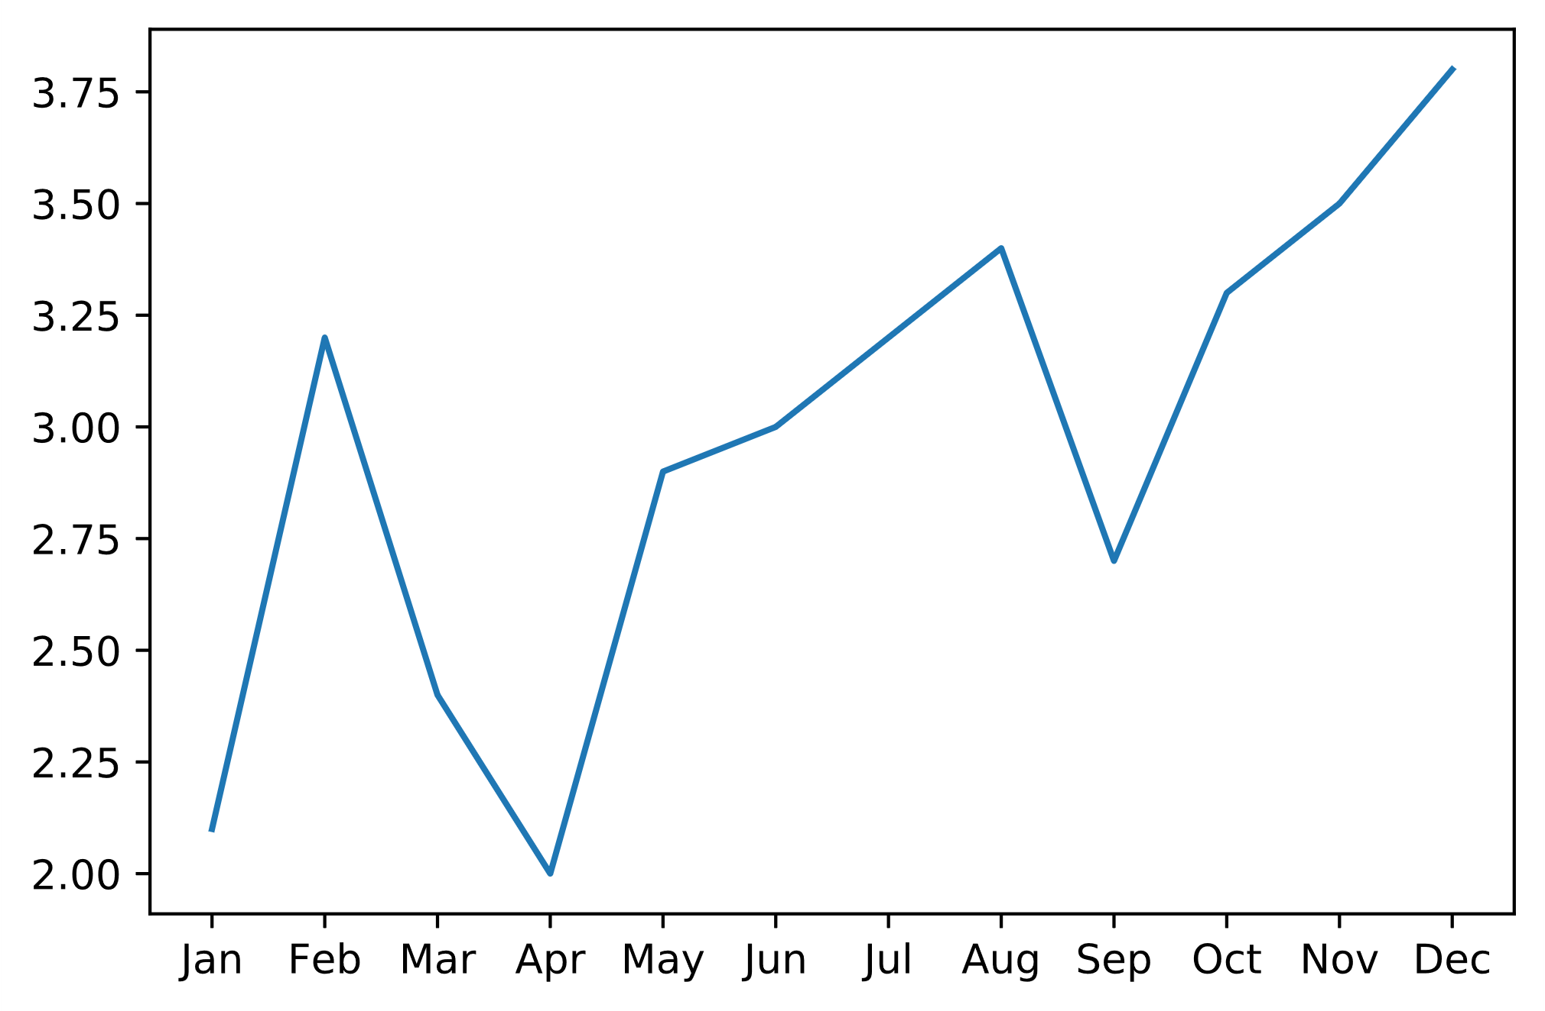
The pyplot.plot() Function
matplotlib.pyplot is main interface for Matplotlib.
Can take NumPy array, DataFrame, etc.
pyplot.plot() does the actual plotting.
Importing as plt saves typing.
Takes x- and y-axis arguments by default.
plt.plot(revenue_df['Month'], revenue_df['Revenue'])

Slide 4
Showing Plots
In Jupyter, plot() automatically displays plot in output cell.
Behavior differs in other execution environments.
pyplot.show() may be necessary.
When executing a script, call at the end.
When working in a shell, call when you want to display plots.
With IPython, you can use %matplotlib magic instead of show() call.

Slide 5
Stateful Interface
One of two interfaces.
Maintains a memory of plots already defined.
With pyplot.plot(), keeps track of figure, axes, formatting, etc.
Works best when plots are simple.
Recall previous example:
plt.plot(revenue_df['Month'], revenue_df['Revenue'])
Limitations:
Only keeps track of "active" plot when pyplot.plot() is called twice.
Changing non-active plot can be difficult.

Slide 6
Object-Oriented Interface
Doesn't keep track of plot state.
You assign objects to a plot, and you can use these objects to modify it.
You must construct Figure and Axes objects.
Example:
fig = plt.figure()
Constructs instance of Figure class.
ax = fig.add_axes([0, 0, 1, 1])
Constructs instance of Axes class using a specific method.
ax.plot(revenue_df['Month'], revenue_df['Revenue'])
Axes object plots the data.
To modify plot, simply reference ax object.
No need to worry about which plot is "active."
This is the preferred approach.

Slide 7
The pyplot.savefig() Function
Saves a plot as a file.
Useful for sharing plots with users or apps.
Gives you more options than simply right-clicking the image from Jupyter.
dpi, quality, etc.
You can provide the format to save as, otherwise it will infer based on file extension.
Example of saving as SVG (stateful):
plt.savefig('revenue_df.svg')
Object-oriented example:
fig.savefig('revenue_df.svg')

Slide 8
Guidelines for Creating and Saving Simple Line Plots
Use plot() to generate a simple line plot.
Consider using the stateful interface for quick and simple plotting.
Prefer to use the object-oriented interface in most scenarios.
Use pyplot.show() when executing from a script or shell.
Use %matplotlib when executing from IPython.
Use savefig() to save a plot as a file.
Provide a relative or absolute path to desired location.
Provide the desired file extension to save as that type.

Slide 9
Activity: Creating and Saving Simple Line Plots
You'll eventually build out more complex visuals.
You'll use them to help you and your team analyze data, and for presenting that data to GCE managers.
To begin, you'll create simple line graphs showing revenue across entire months.
May help you identify trends in sales.

Slide 10
Create Subplots
Topic B

Slide 11
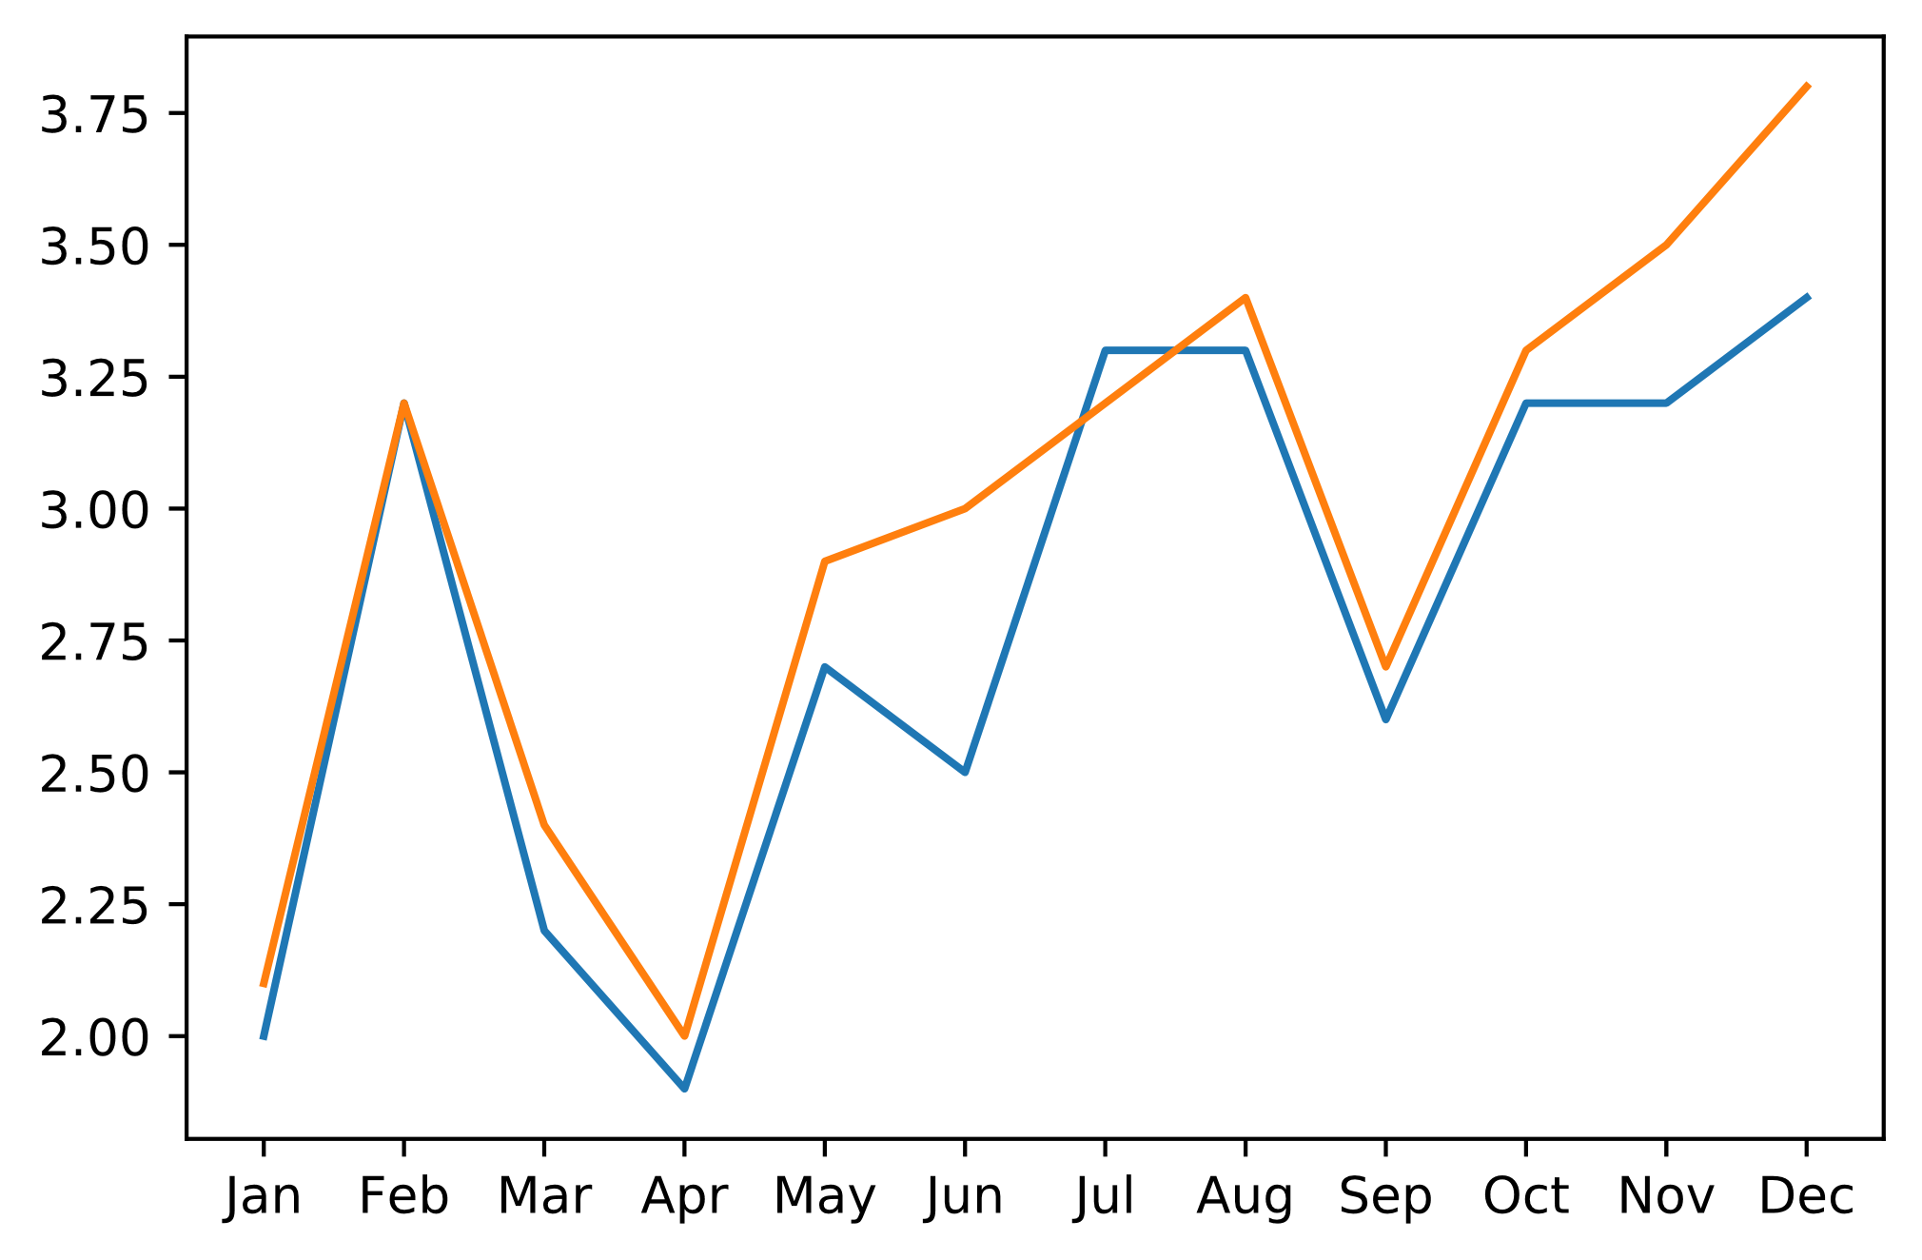
Modular Plotting (2019 vs. 2020 Revenue)
plt.plot(slice_2019.index.get_level_values(0), slice_2019['Revenue'])
plt.plot(slice_2020.index.get_level_values(0), slice_2020['Revenue'])
2020
2019

Slide 12
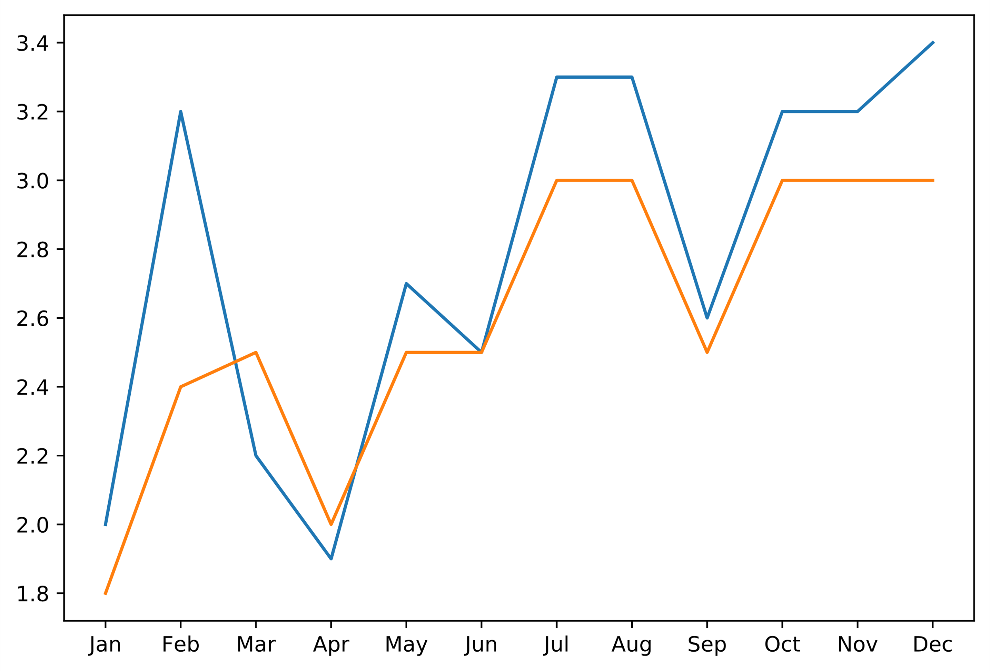
Modular Plotting (2019 Revenue vs. Expenses)
fig = plt.figure()
ax = fig.add_axes([0, 0, 1, 1])
ax.plot(slice_2019.index.get_level_values(0), slice_2019['Revenue'])
ax.plot(slice_2019.index.get_level_values(0), slice_2019['Expenses'])
Revenue
Expenses

Slide 13
Subplotting
There's only so much room to work with in one plot.
Avoid clutter/noisiness.
Comparing revenue and expenses from 2019/2020 might be too much for one plot.
Data is also on different scales.
Subplotting is another approach.
Multiple smaller plots part of a whole.
Each plot has its own axes.
Each subplot might be:
Revenue for 2019
Revenue for 2020
Expenses for 2019
Expenses for 2020
Both modular plotting and subplotting can be used together.

Slide 14
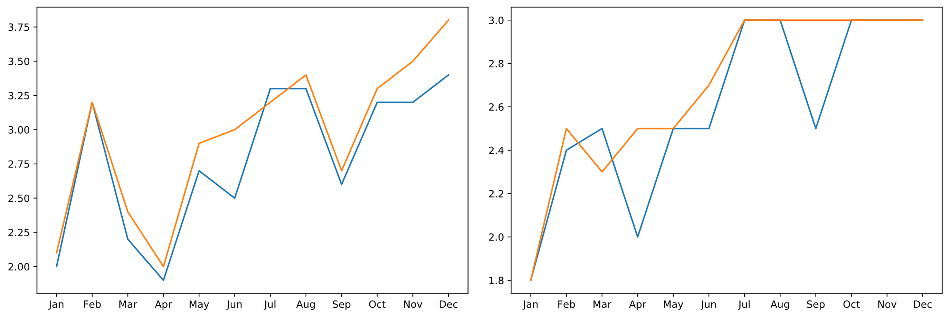
The Figure.add_axes() Function
fig = plt.figure()
ax1 = fig.add_axes([0, 1, 1, 1])
ax2 = fig.add_axes([1.1, 1, 1, 1])
... # Plotting code.
Revenue
Expenses

Slide 15
The Figure.add_subplot() Function (Slide 1 of 2)
Another approach to defining subplots.
Pass arguments into functions:
Number of rows of subplots
Number of columns of subplots
Position of specific subplot
To create a 2 × 2 grid:
fig = plt.figure(figsize = (10, 6))
ax1 = fig.add_subplot(2, 2, 1)
ax2 = fig.add_subplot(2, 2, 2)
ax3 = fig.add_subplot(2, 2, 3)
ax4 = fig.add_subplot(2, 2, 4)
No need to add axes with specific dimensions.
Still somewhat tedious.

Slide 16
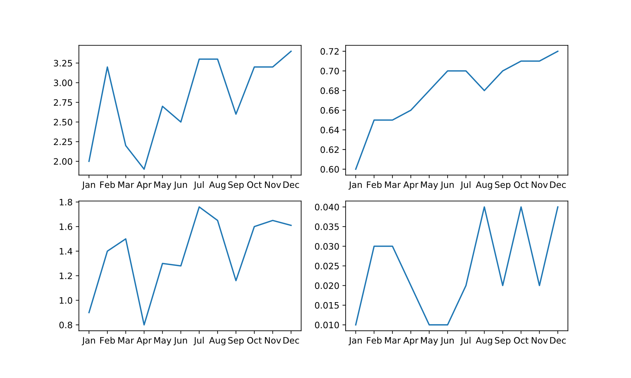
The Figure.add_subplot() Function (Slide 2 of 2)
Revenue
COGS
Axis 1
Axis 2
Axis 3
Axis 4
Payroll
Utilities

Slide 17
The Figure.subplots() Function (Slide 1 of 2)
Defines grid and returns NumPy array for Axes object.
To create a 3 × 2 grid:
fig = plt.figure(figsize = (10, 8))
ax = fig.subplots(3, 2)
Use NumPy indexing on array to get each subplot:
ax[0, 0].plot(slice_2019.index.get_level_values(0), slice_2019['Revenue'])
ax[0, 1].plot(slice_2019.index.get_level_values(0), slice_2019['COGS'])
ax[1, 0].plot(slice_2019.index.get_level_values(0), slice_2019['Payroll'])
ax[1, 1].plot(slice_2019.index.get_level_values(0), slice_2019['Utilities'])
ax[2, 0].plot(slice_2019.index.get_level_values(0), slice_2019['Interest'])
ax[2, 1].plot(slice_2019.index.get_level_values(0), slice_2019['Taxes'])

Slide 18
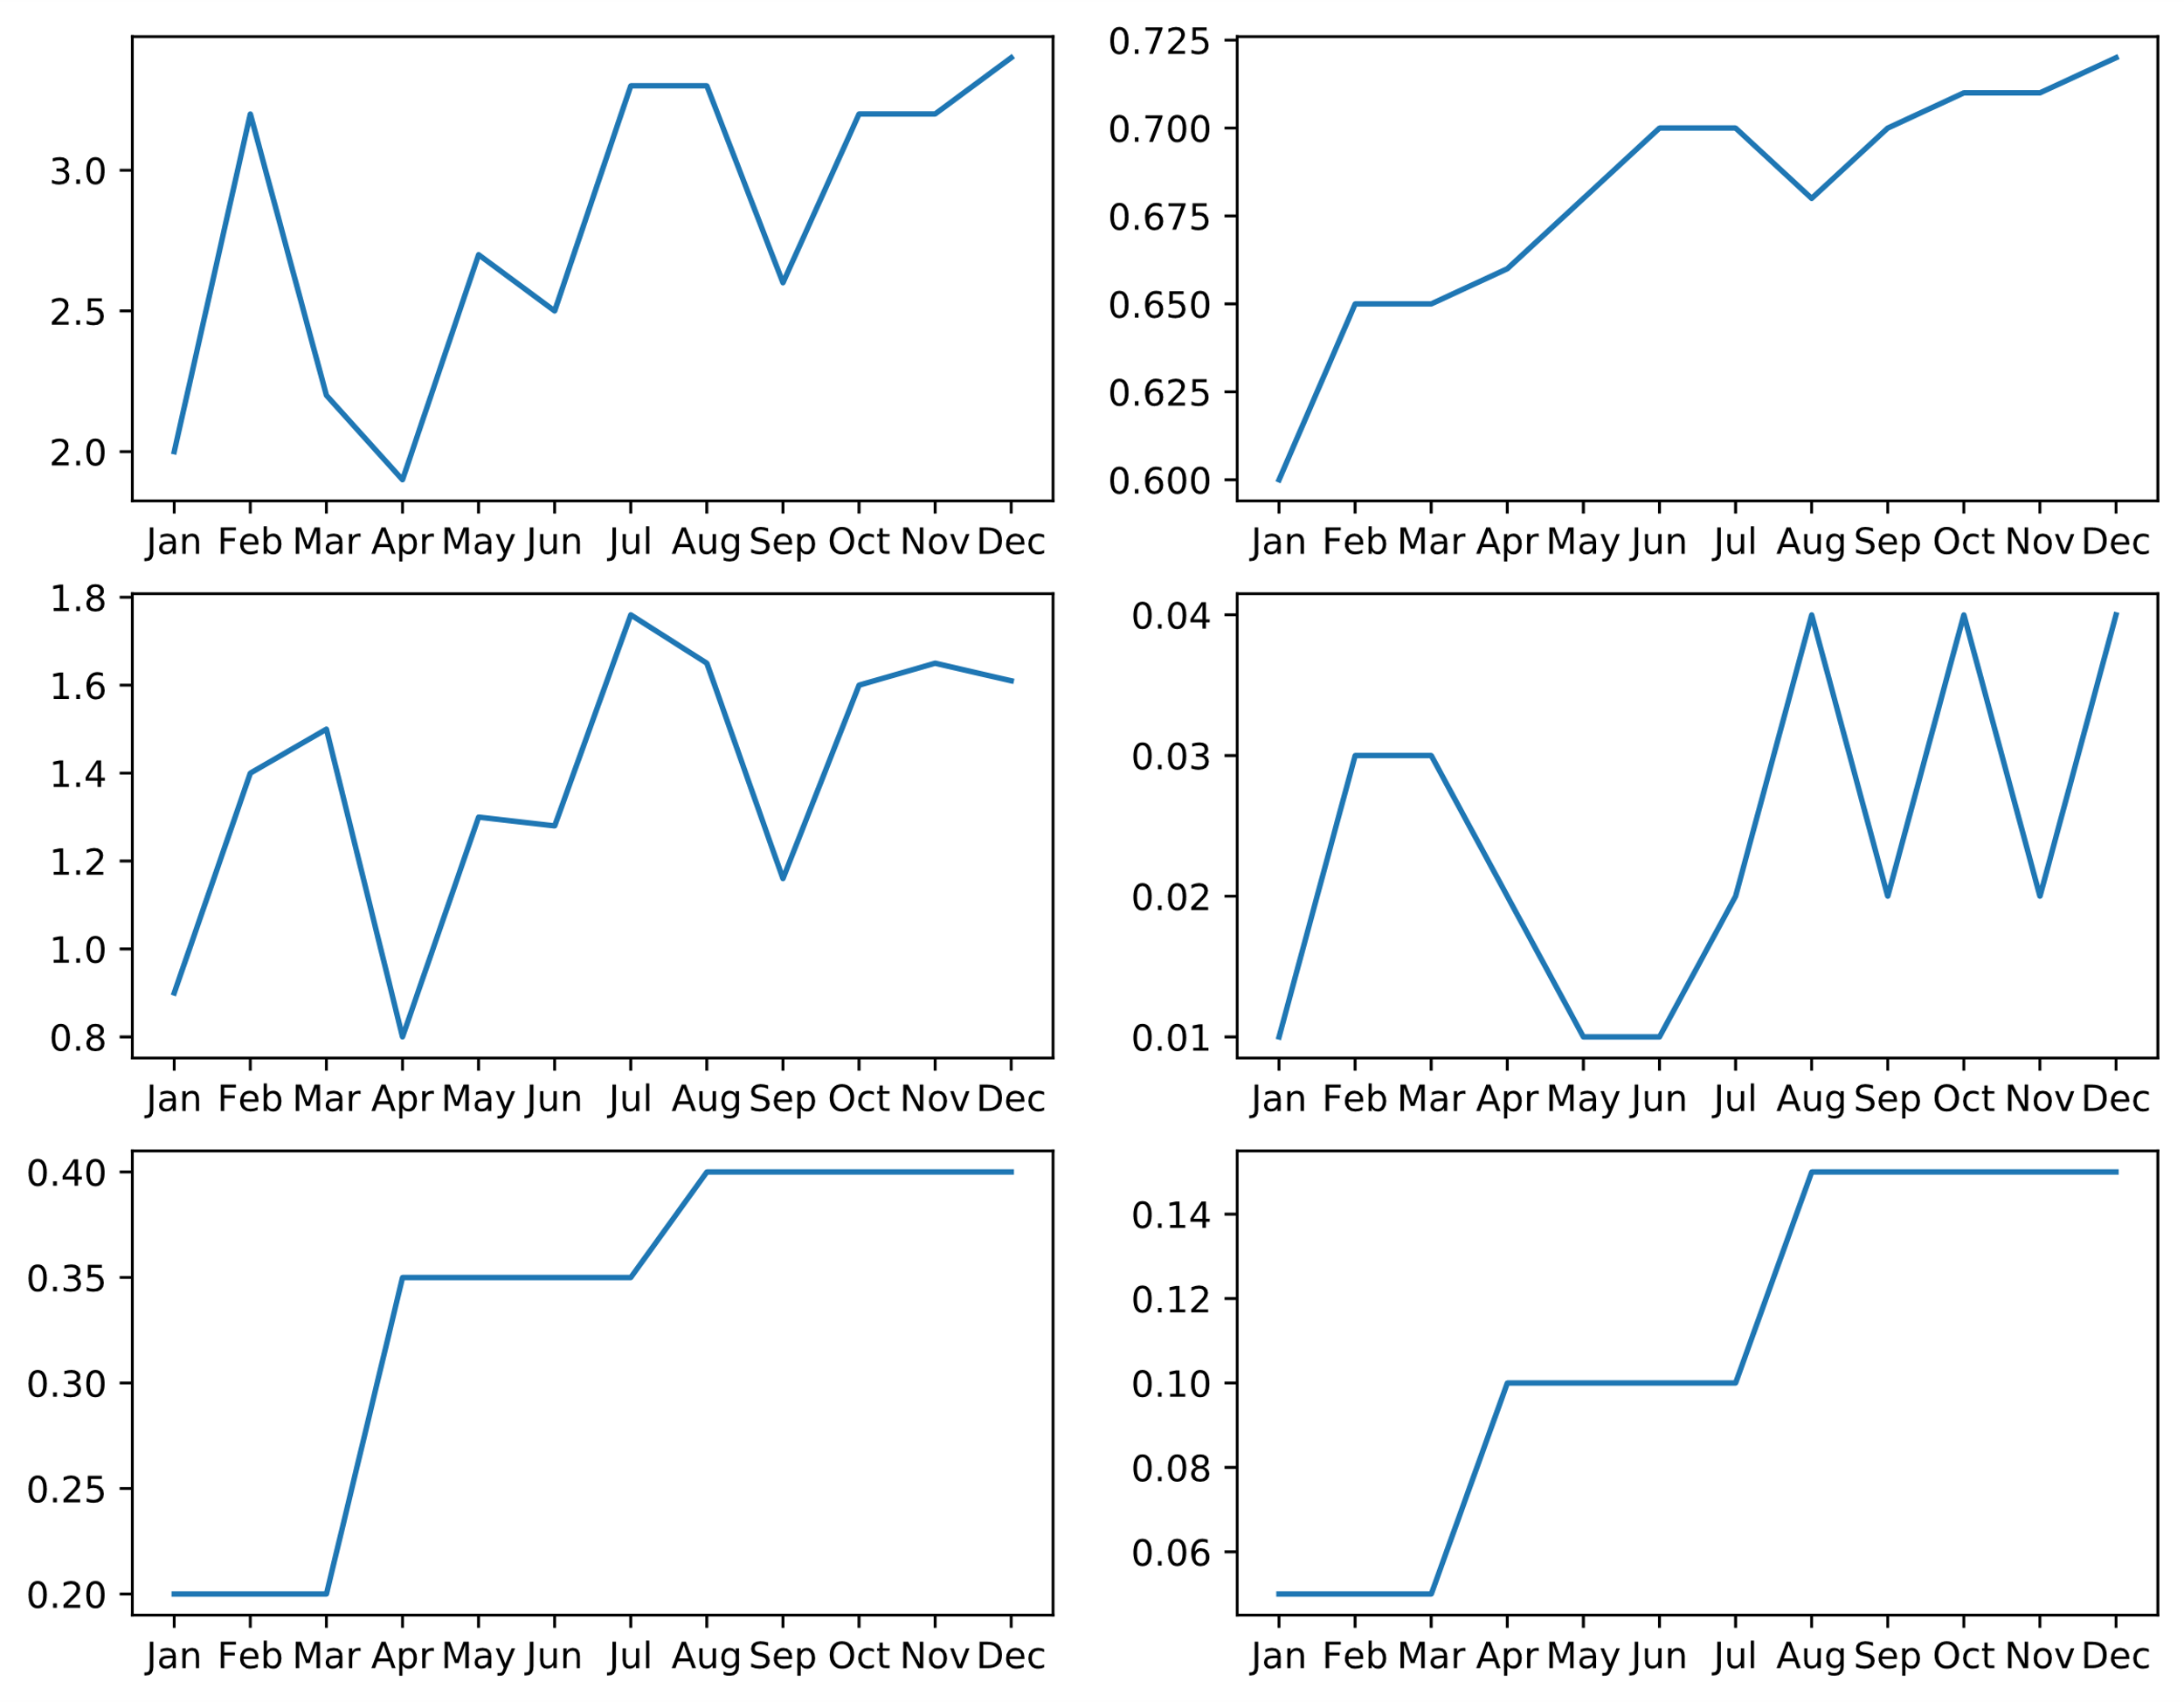
The Figure.subplots() Function (Slide 2 of 2)
Revenue
COGS
[0, 0]
[0, 1]
Payroll
Utilities
[1, 0]
[1, 1]
Interest
Taxes
[2, 0]
[2, 1]

Slide 19
Shared Axes (Slide 1 of 2)
What if you want to compare the overall value of each expense?
Place subplots on shared axis.
Two arguments for subplots(): sharex and sharey
For each, specify one of four options:
'none' —Axis will be independent for each subplot.
'all' —Axis will be shared between all subplots.
'row' —Axis will be shared between each row.
'col' —Axis will be shared between each column.
Example where all subplots in each column have same x-axis, and all subplots in each row have same y-axis:
fig = plt.figure(figsize = (10, 6))
ax = fig.subplots(2, 2, sharex = 'col', sharey = 'row')
... # Plotting code.

Slide 20
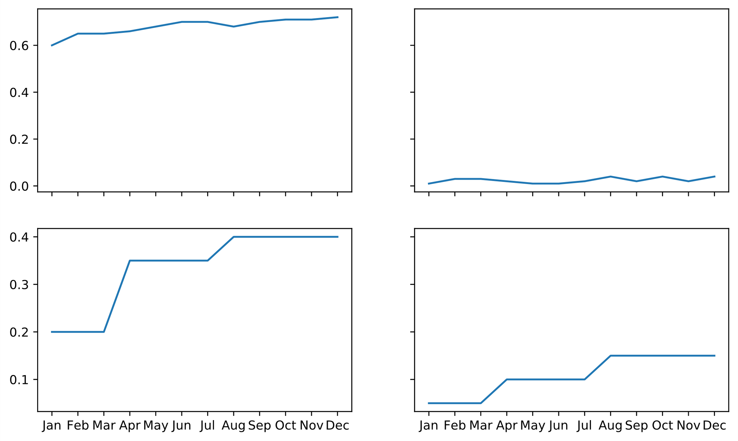
Shared Axes (Slide 2 of 2)
COGS
Utilities
Shared y-axis
Shared x-axis
Shared x-axis
Shared y-axis
Interest
Taxes

Slide 21
The GridSpec Object (Slide 1 of 2)
Enables fine tuning of grid layouts.
Create layout through add_gridspec() function:
fig = plt.figure(figsize = (13, 6))
grid = fig.add_gridspec(2, 2, width_ratios = [.6, .4])
After setting up grid, set up subplots on grid:
ax1 = fig.add_subplot(grid[0:, 0])
ax2 = fig.add_subplot(grid[0, 1])
ax3 = fig.add_subplot(grid[1, 1])
First subplot takes up two grid spaces.
Then, plot as normal:
ax1.plot(slice_2019.index.get_level_values(0), slice_2019['Revenue'])
ax2.plot(slice_2019.index.get_level_values(0), slice_2019['Payroll'])
ax3.plot(slice_2019.index.get_level_values(0), slice_2019['COGS'])

Slide 22
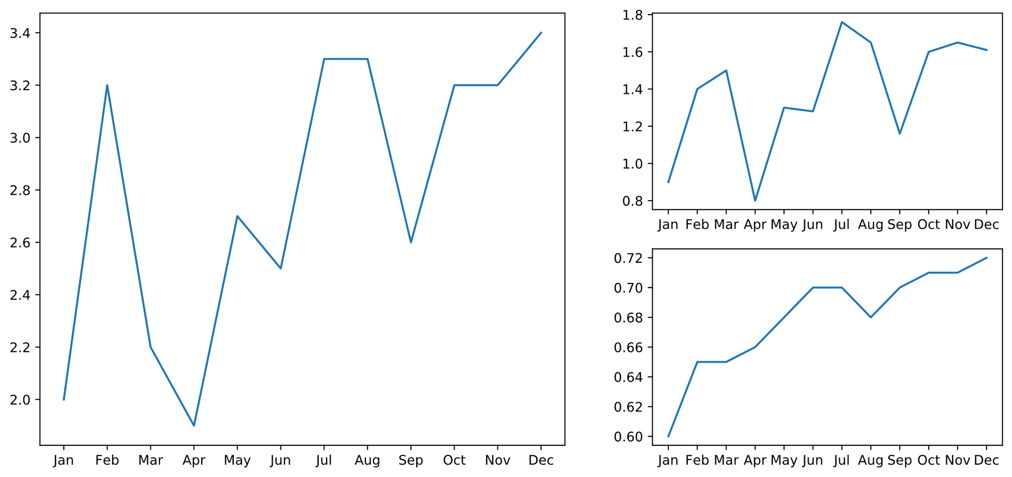
The GridSpec Object (Slide 2 of 2)
Revenue
Payroll
[0, 1]
Subplot spans two rows
COGS
[0:, 0]
[1, 1]

Slide 23
Guidelines for Creating Subplots
Use modular plotting to compare related data visualizations on one graph.
Avoid adding too much to a modular plot.
Use subplotting to compare related data visualizations in self-contained plots.
Consider subplotting when modular plotting gets too noisy.
Combine modular plotting and subplotting for maximum effect.
Prefer to use Figure.subplots() to create subplots.
Consider plotting subplots with shared axes to reduce clutter and change scale.
Construct a GridSpec object to exercise more granular control over figure layout.
Prefer to use Figure.add_subplot() for GridSpec.

Slide 24
Activity: Creating Subplots
Consider how GCE subplots will be laid out.
Some will benefit from being combined.
Will be viewed within the proper context.
You'll modularize and combine line graphs into multiple subplots.

Slide 25
Create Common Types of Plots
Topic C

Slide 26
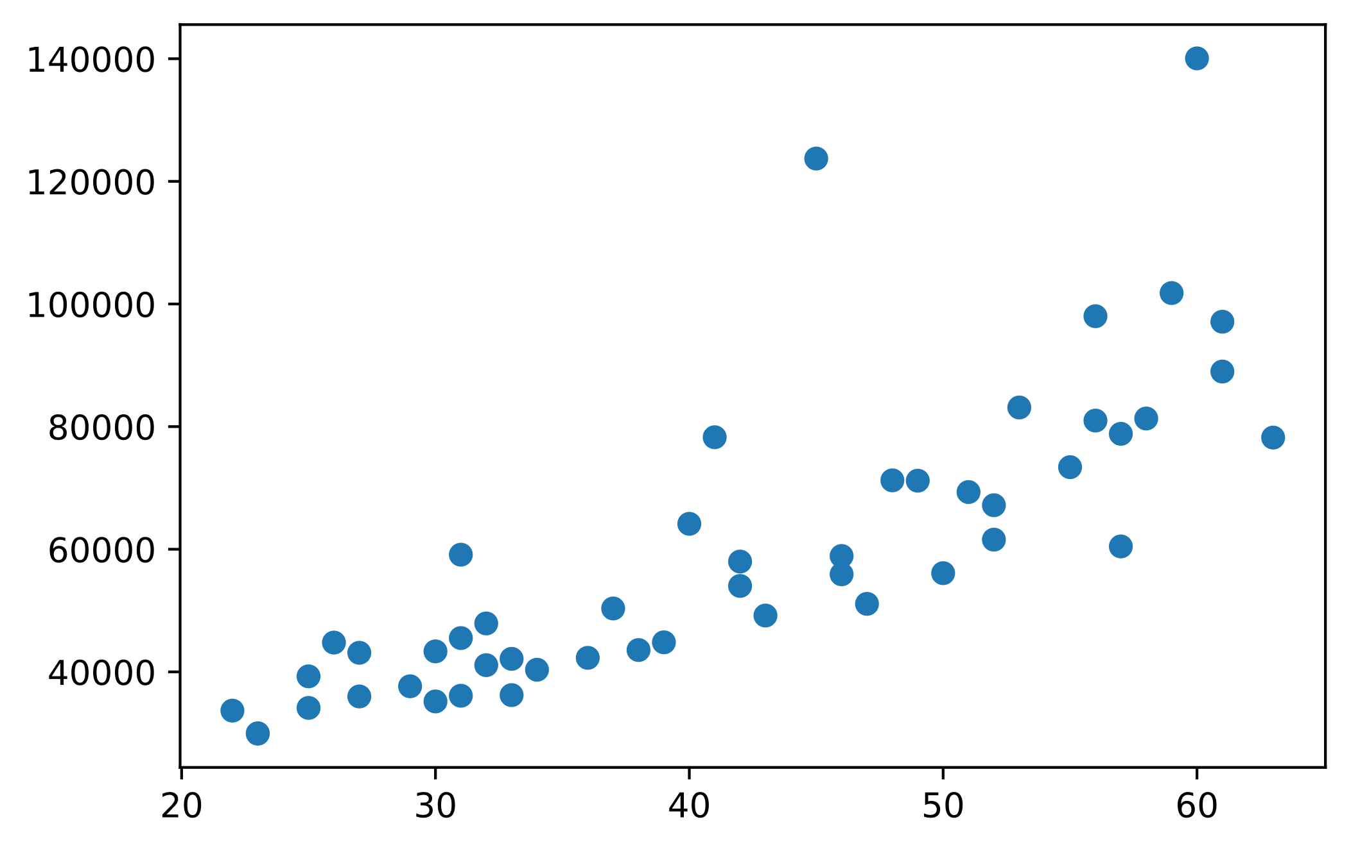
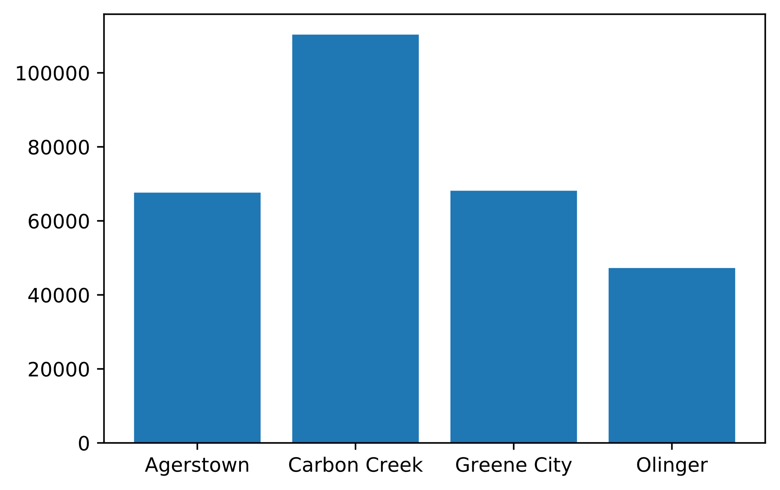
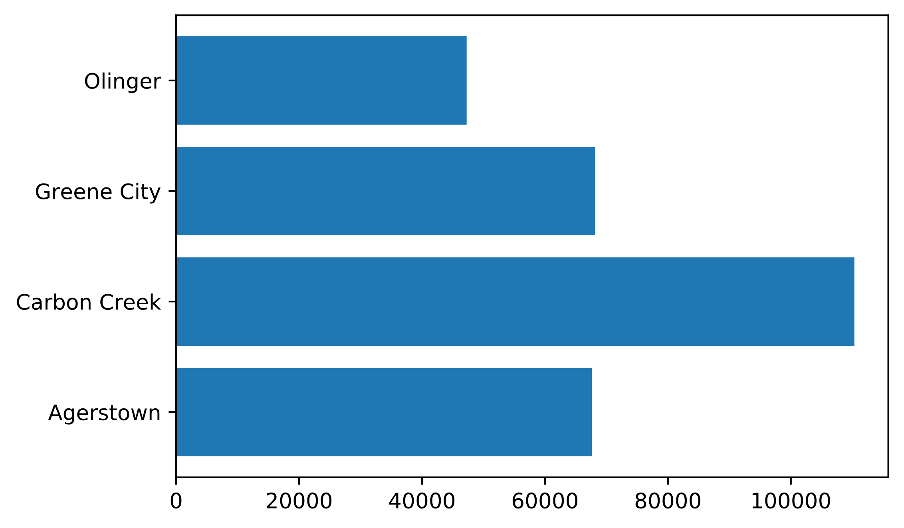
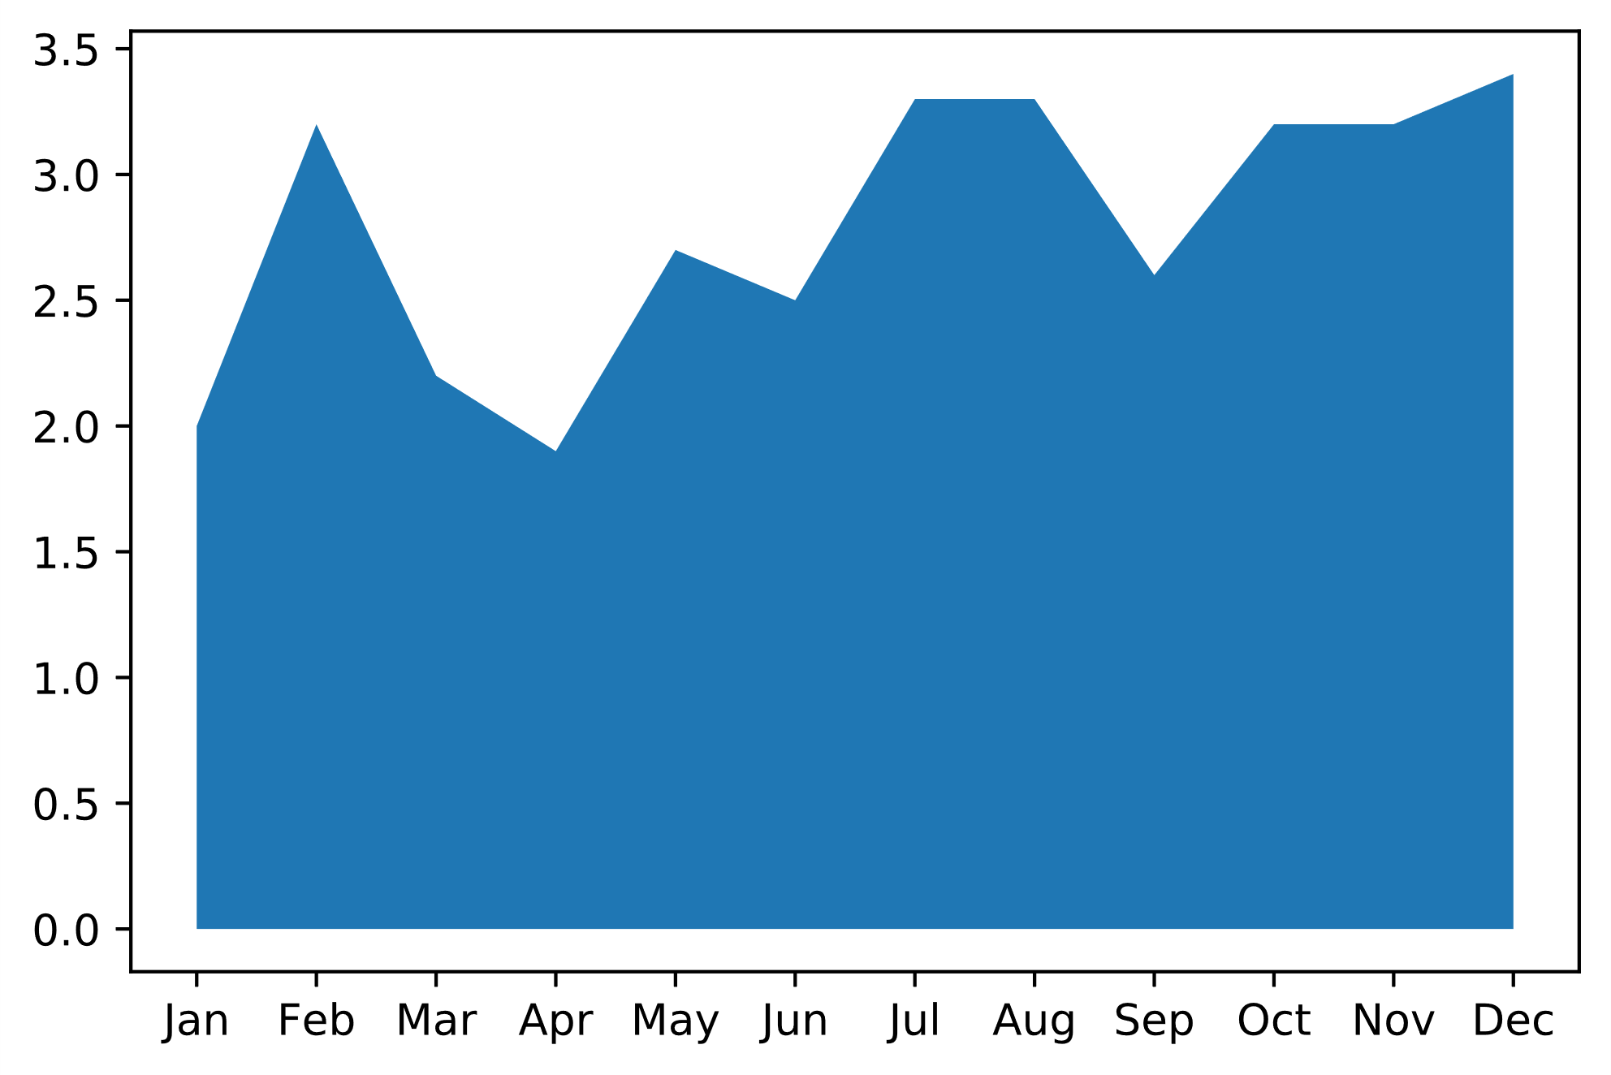
Common Plot Types (Slide 1 of 2)
pyplot.scatter(x, y)
pyplot.plot(x, y)
pyplot.stackplot(x, y)
pyplot.bar(x, height)
pyplot.barh(x, width)

Slide 27
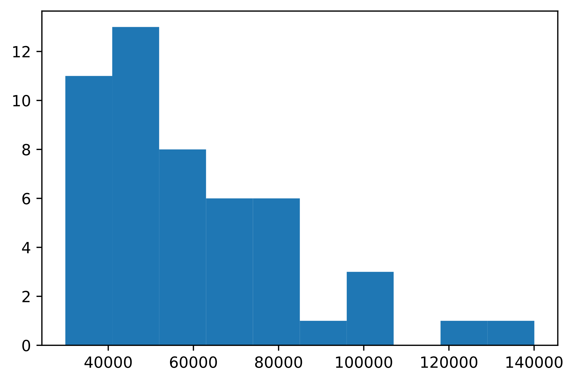
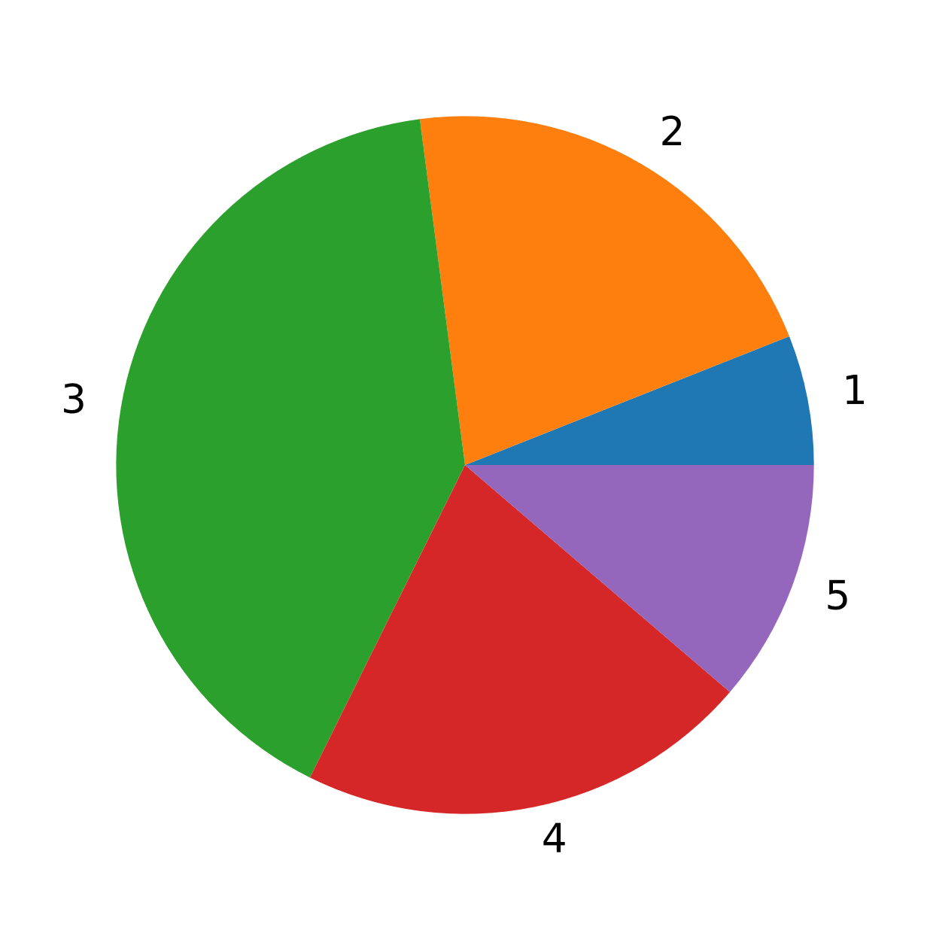
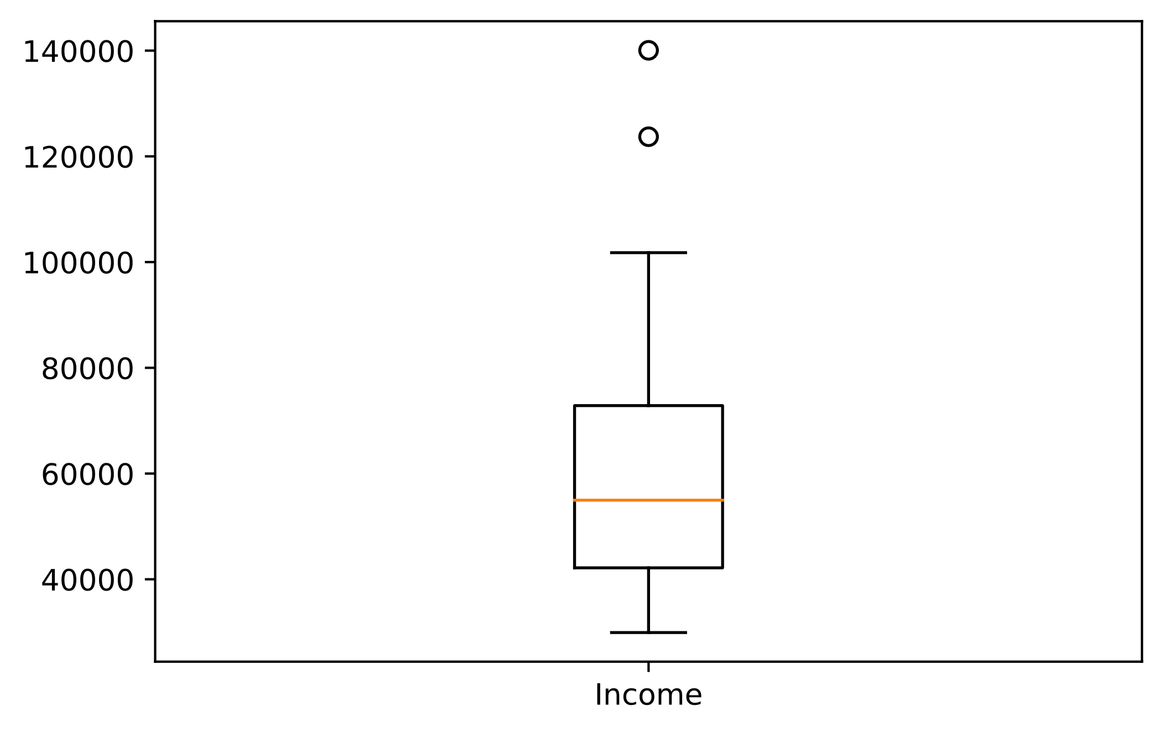
Common Plot Types (Slide 2 of 2)
pyplot.hist(x)
pyplot.boxplot(x)
pyplot.pie(x)

Slide 28
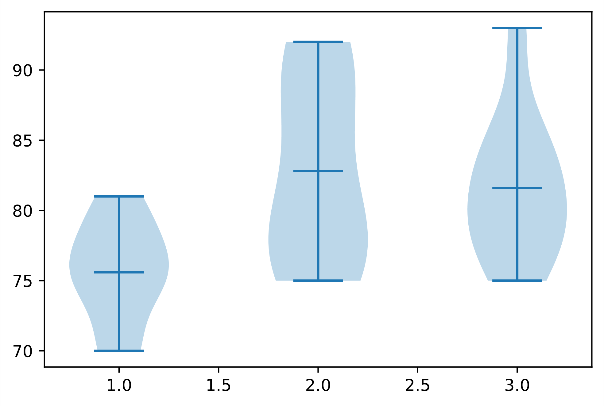
Violin Plots
temps = [jun_temp, jul_temp, aug_temp]
fig, ax = plt.subplots()
ax.violinplot(temps, showmeans = True)
Low probability
Mean
Temp.
High probability
Jun
Jul
Aug

Slide 29
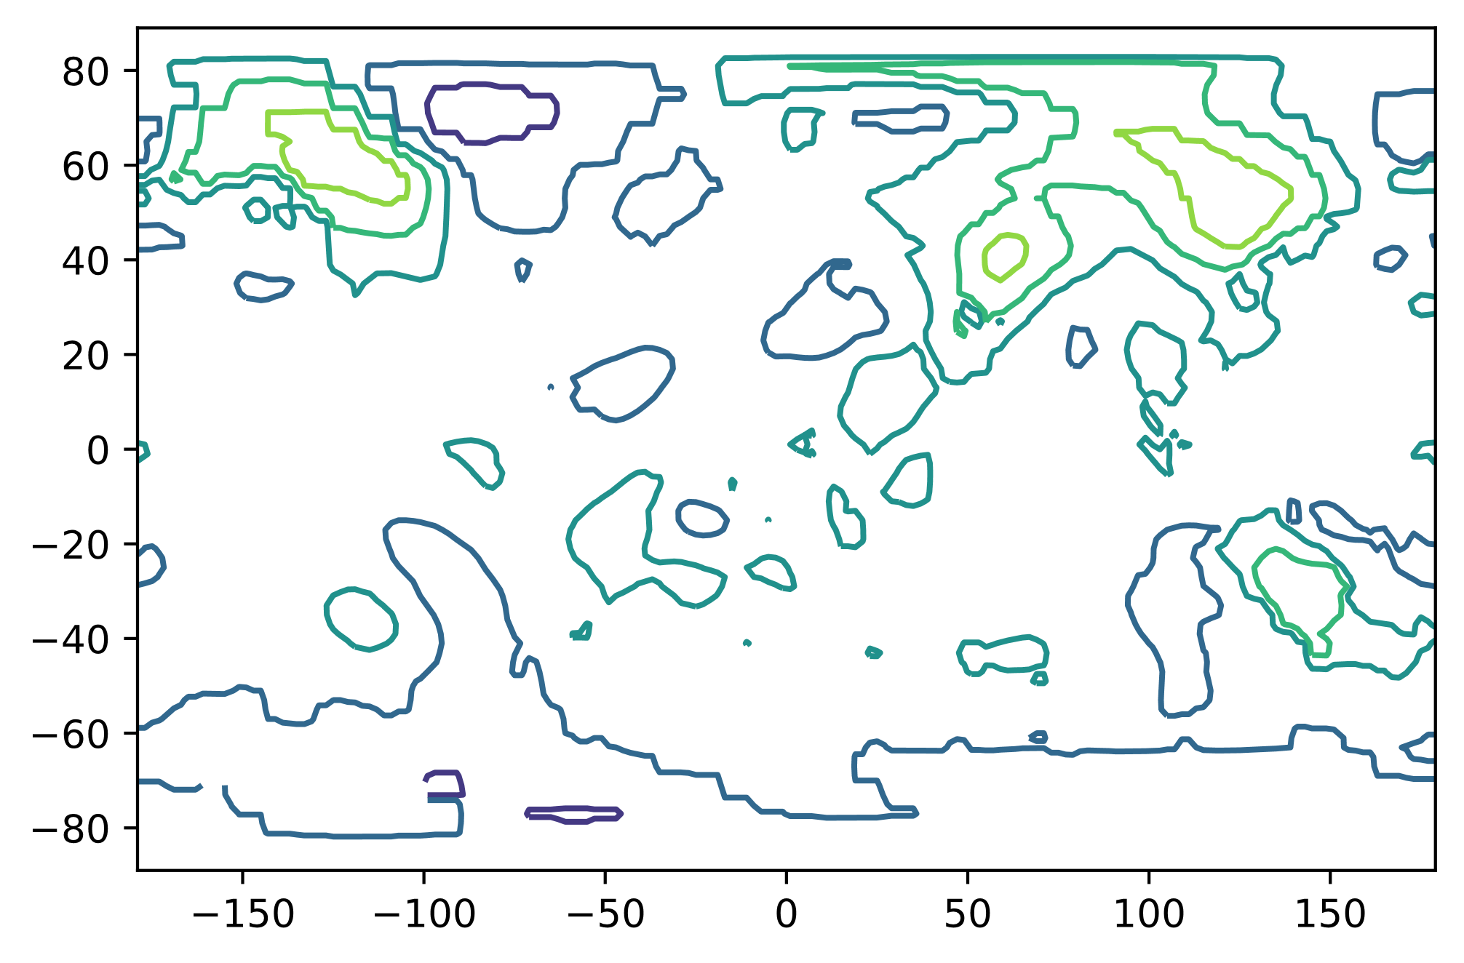
Contour Plots
lon_grid, lat_grid = numpy.meshgrid(lon, lat)
fig, ax = plt.subplots()
ax.contour(lon_grid, lat_grid, anom)
Negative anomaly
Positive anomaly
Latitude
Longitude

Slide 30
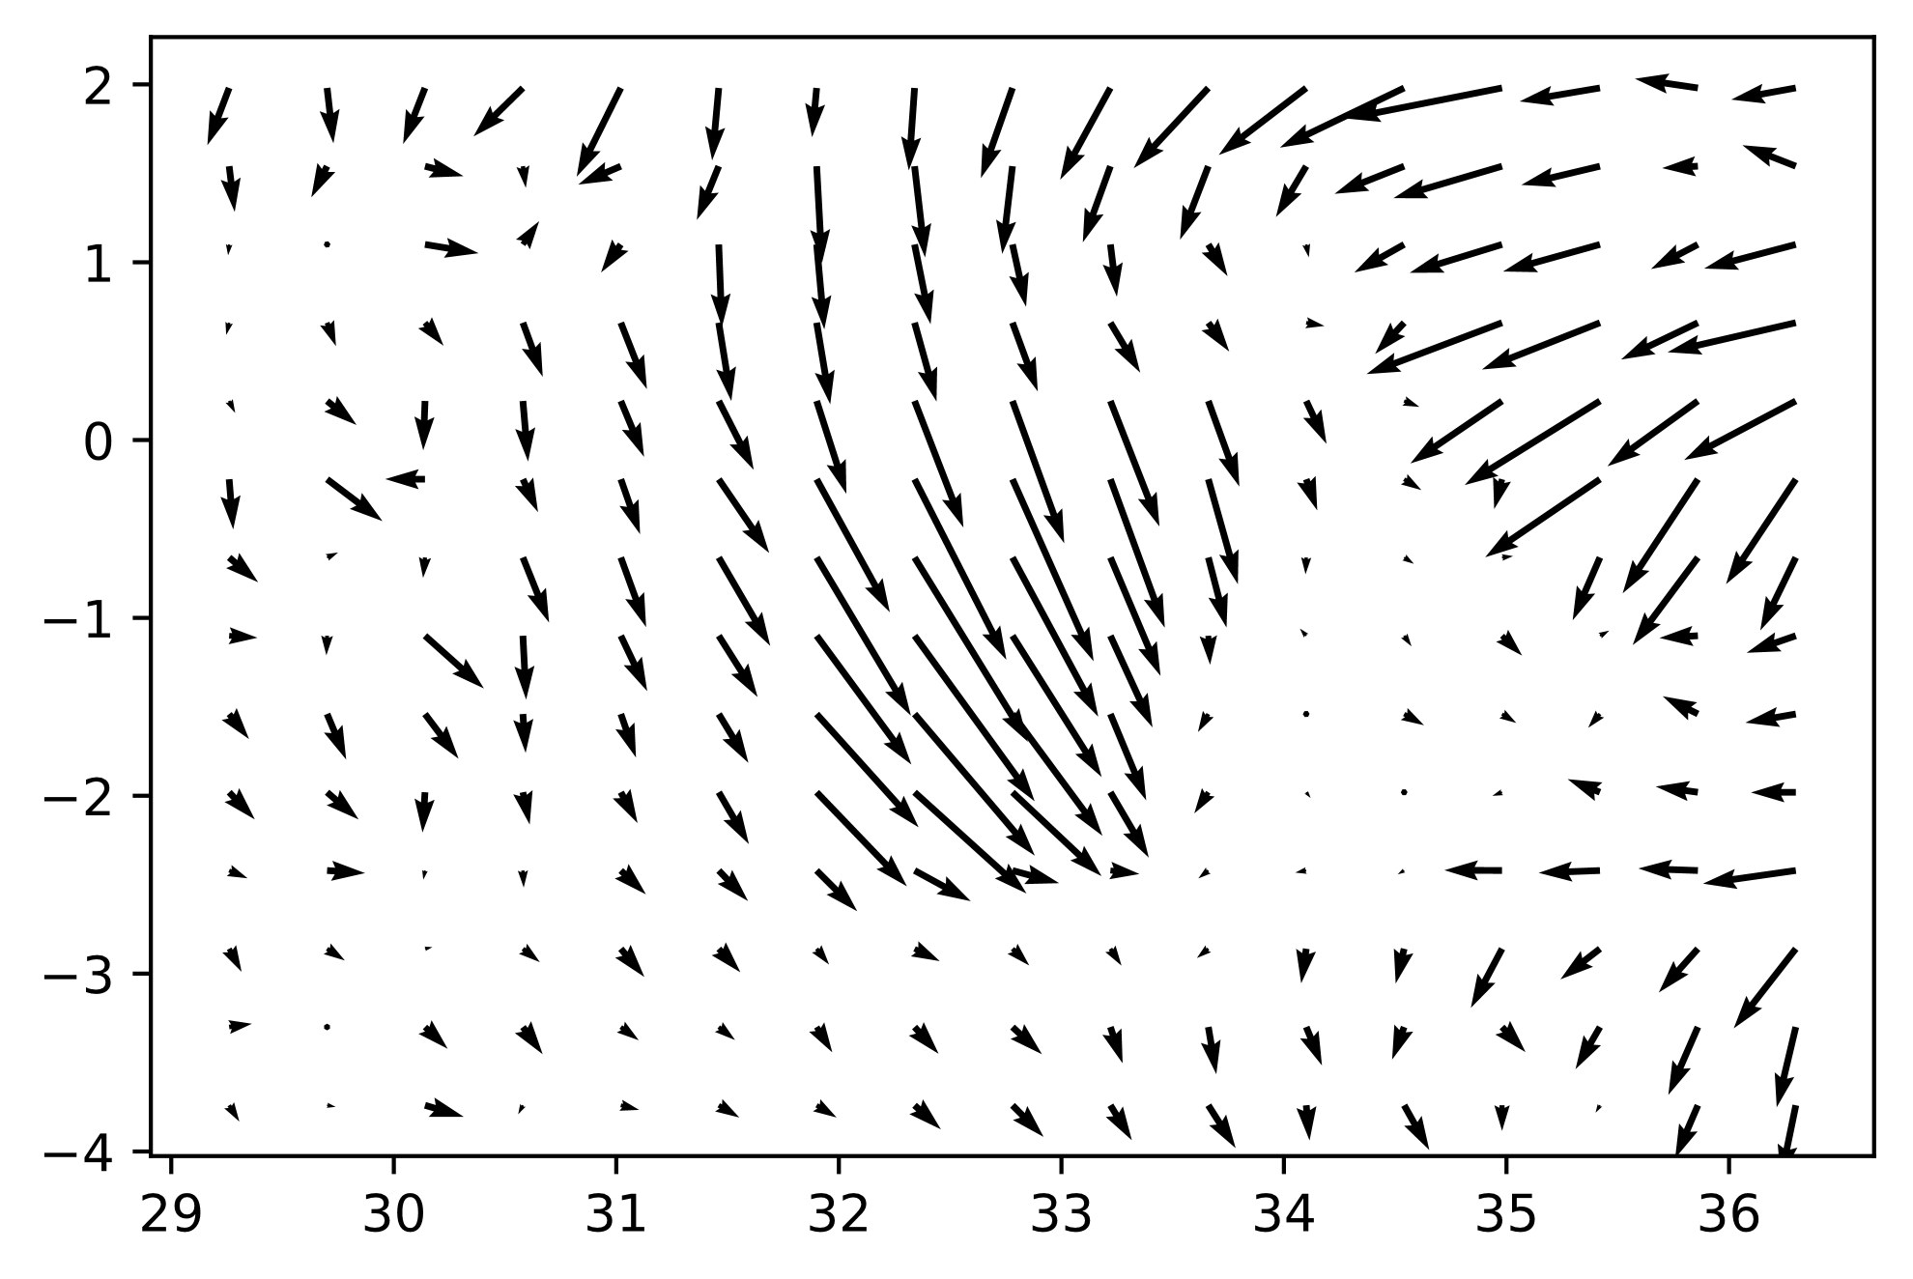
Quiver Plots
fig, ax = plt.subplots()
ax.quiver(lon, lat, wind_u, wind_v)
Latitude
Longitude

Slide 31
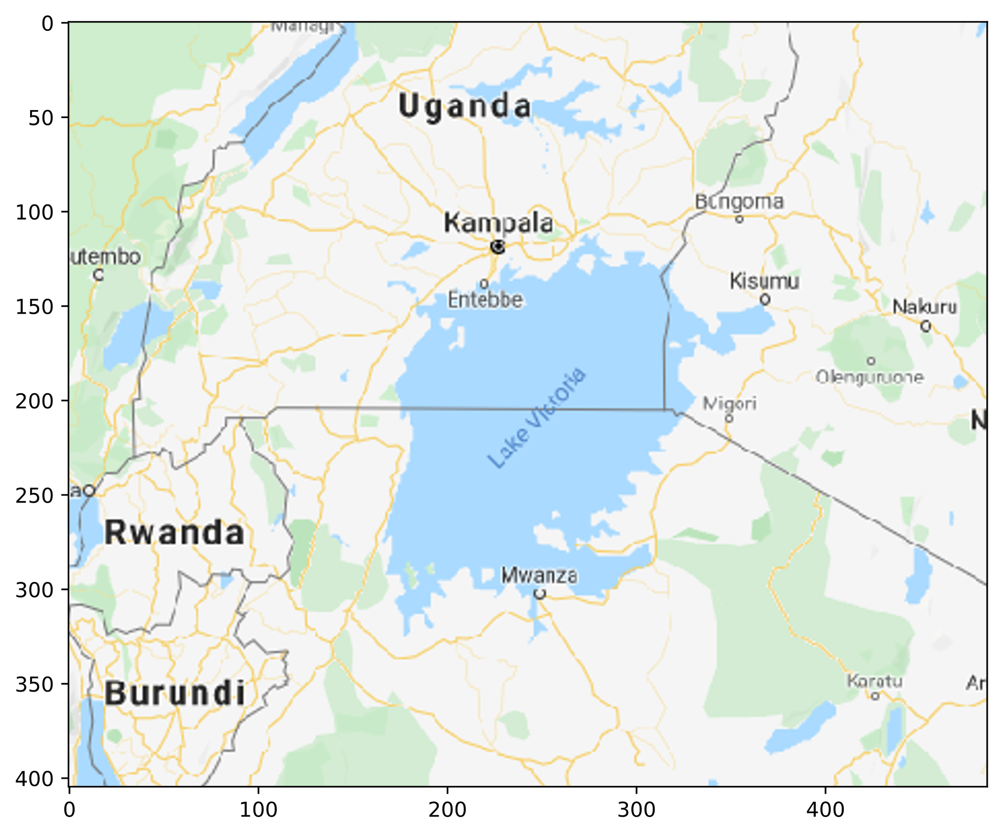
Image Plots
img = mpimg.imread('map_image.png')
fig, ax = plt.subplots(figsize = (8, 8))
ax.imshow(img)
Height
Width

Slide 32
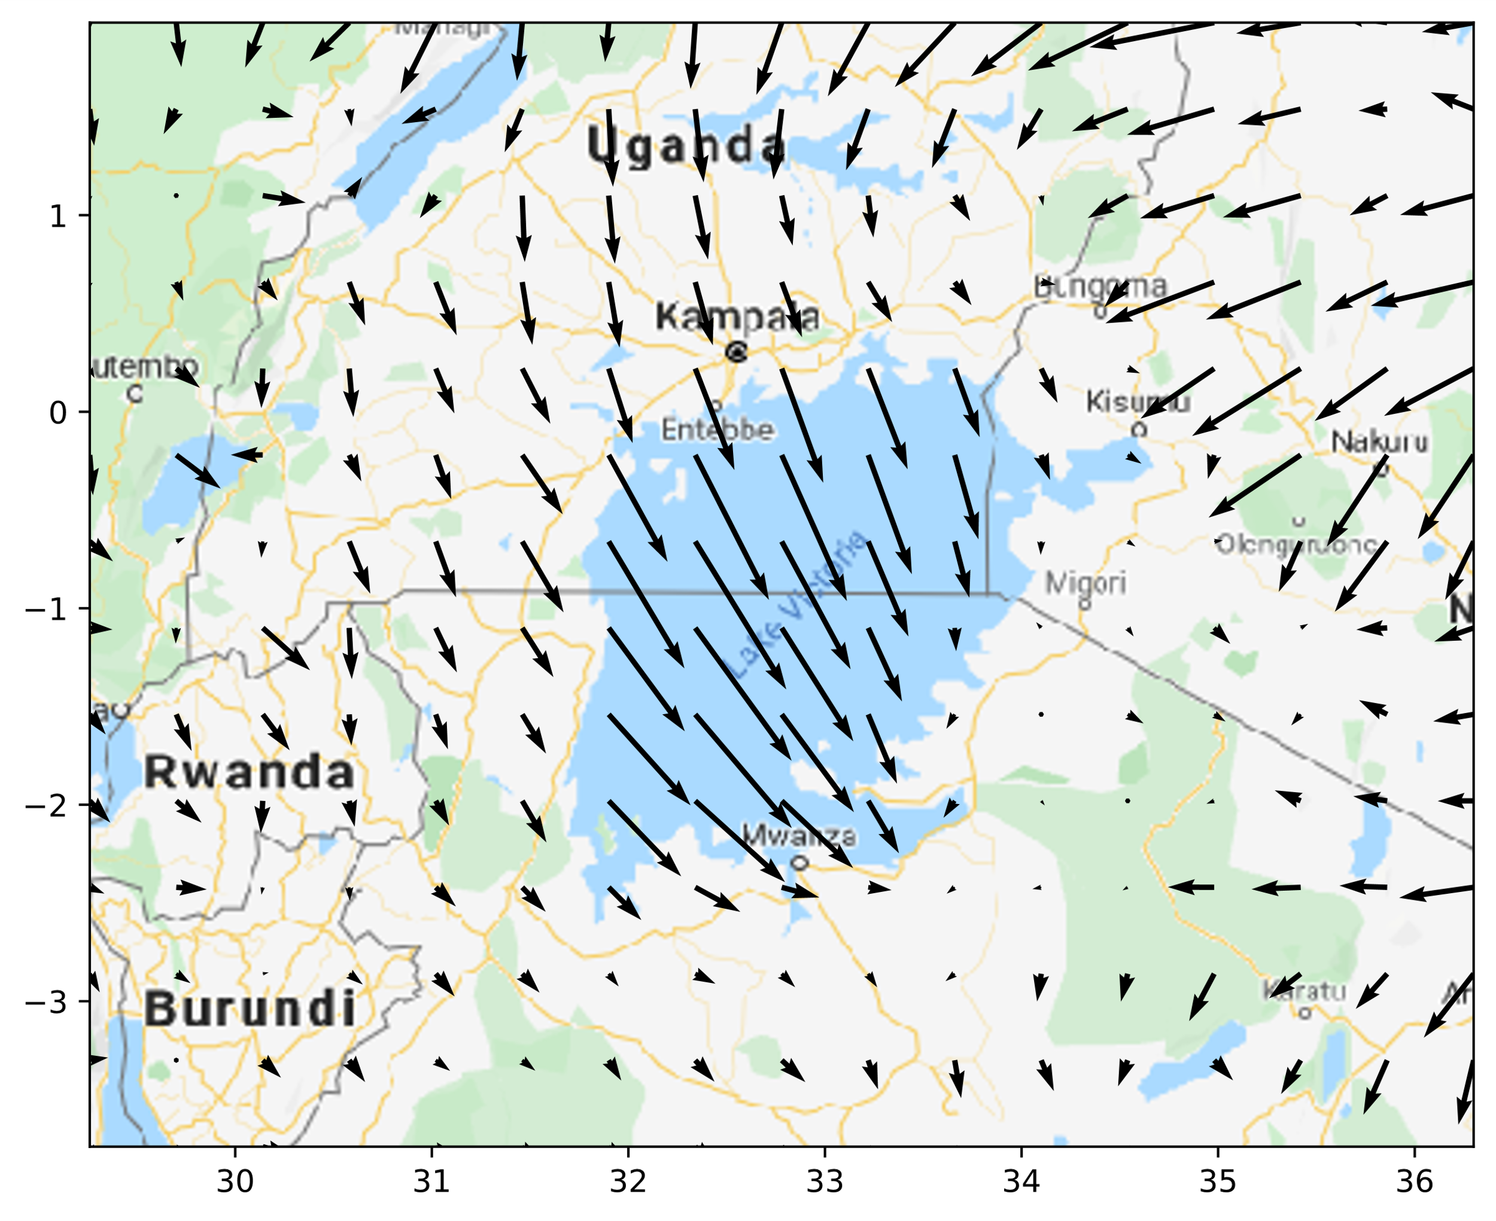
Contextual Image Plot Example
fig, ax = plt.subplots(figsize = (8, 8))
ax.imshow(img, extent = [numpy.amin(lon), numpy.amax(lon),
numpy.amin(lat), numpy.amax(lat)])
ax.quiver(lon, lat, wind_u, wind_v)
Latitude
Longitude

Slide 33
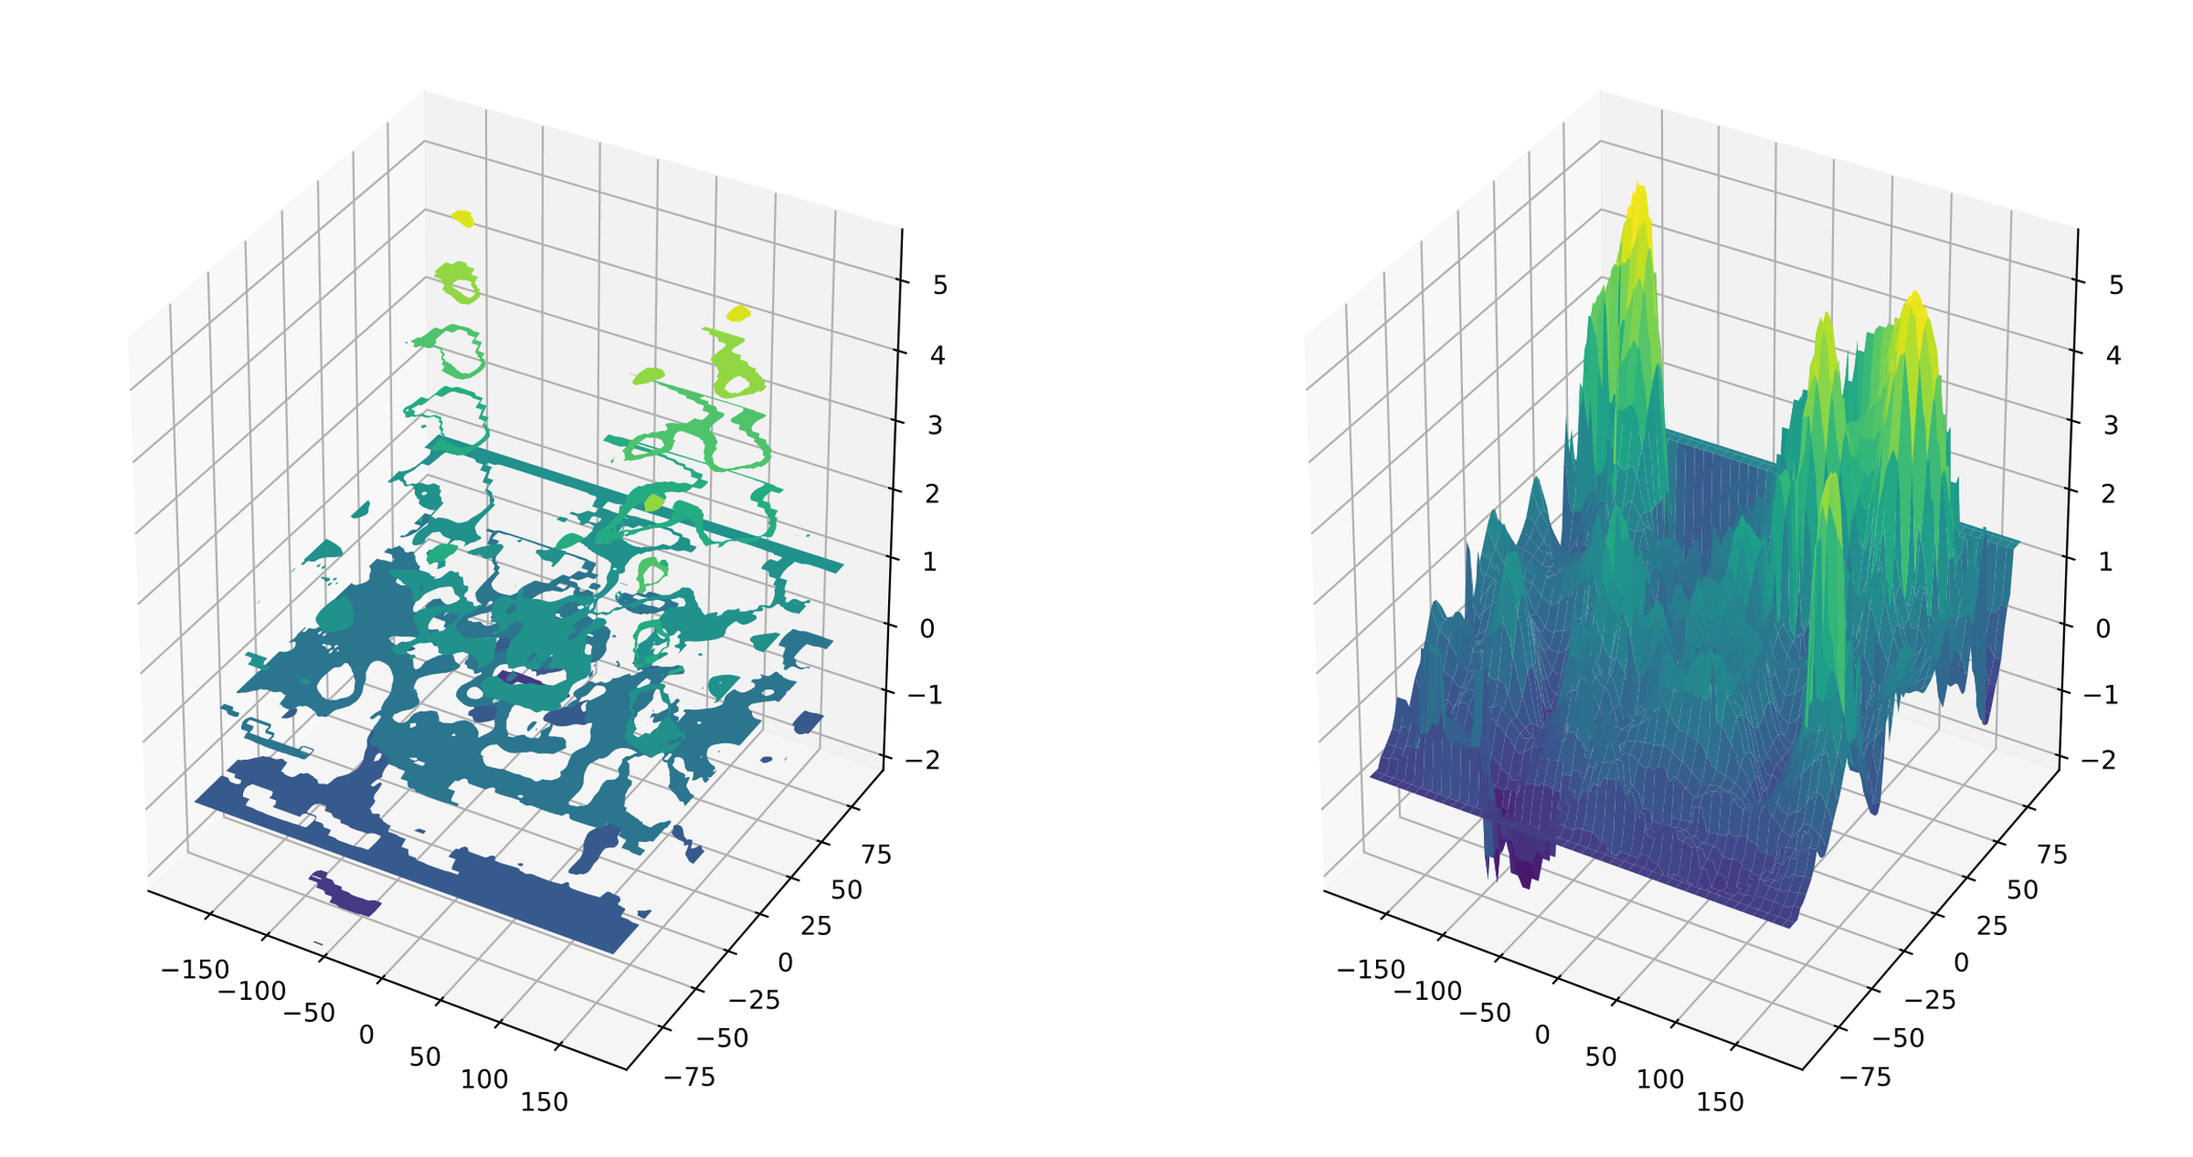
3-D Plots
fig = plt.figure()
ax1 = fig.add_subplot(1, 2, 1, projection = '3d')
ax2 = fig.add_subplot(1, 2, 2, projection = '3d')
ax1.contourf(lon_grid, lat_grid, temp_anomaly)
ax2.plot_surface(lon_grid, lat_grid, temp_anomaly, cmap = 'viridis')
3D Contour
Surface Plot
Temp.
Latitude
Latitude
Longitude
Longitude

Slide 34
Guidelines for Creating Common Types of Plots
Use the familiar plots for the same purposes as mentioned earlier.
Use violin plots to demonstrate KDE, rather than histogram bins.
Use to avoid having to choosing bin size.
Wider areas of violin have greater probability of data being in that range, and vice versa.
Use contour plots to demonstrate how z changes with respect to x and y.
Use to show a topographical map.
Use to show density of large datasets.
Apply numpy.meshgrid() to any one-dimensional inputs.
Use quiver plots to demonstrate four-dimensional data in two dimensions.
Use to show processes with magnitude and direction.
Use either 1-D inputs or 2-D grid inputs.
Use image plots to demonstrate bitmap images.
Use to change image properties.
Use to add context to another plot.
Use image.imread() for PNG images.
Use 3-D plots to demonstrate data in three visible dimensions.
Use Figure.add_subplot(projection = '3d')
Use many of the same 2-D plotting functions to make them 3-D.
Use plotting functions specific to 3-D.

Slide 35
Activity: Creating Common Types of Plots
There are many ways to plot the GCE store data.
You'll generate multiple types of plots.
Try to find actionable info from them.
Information might help change the direction the business takes.

Slide 36
Format Plots
Topic D

Slide 37
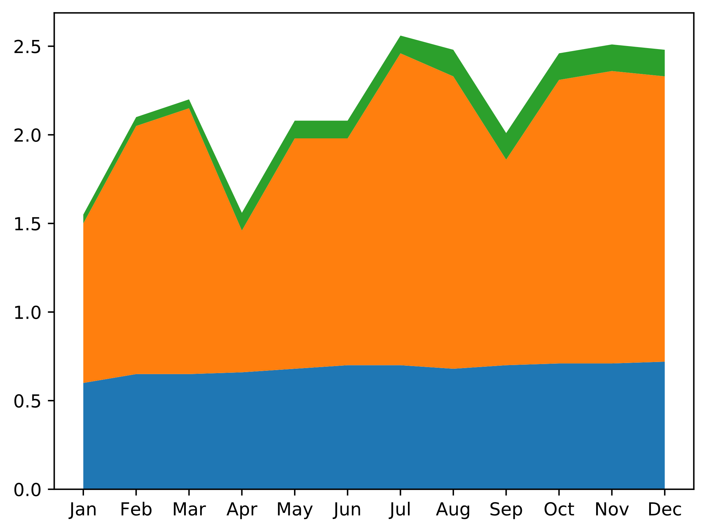
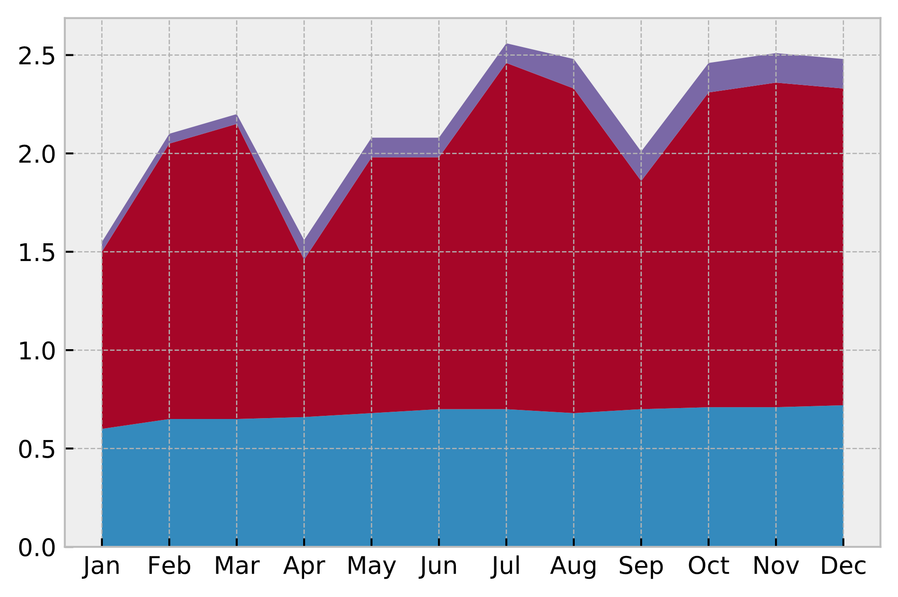
The style.use() Function
plt.style.use('bmh')
... # Plotting code.
'default'
'bmh'

Slide 38
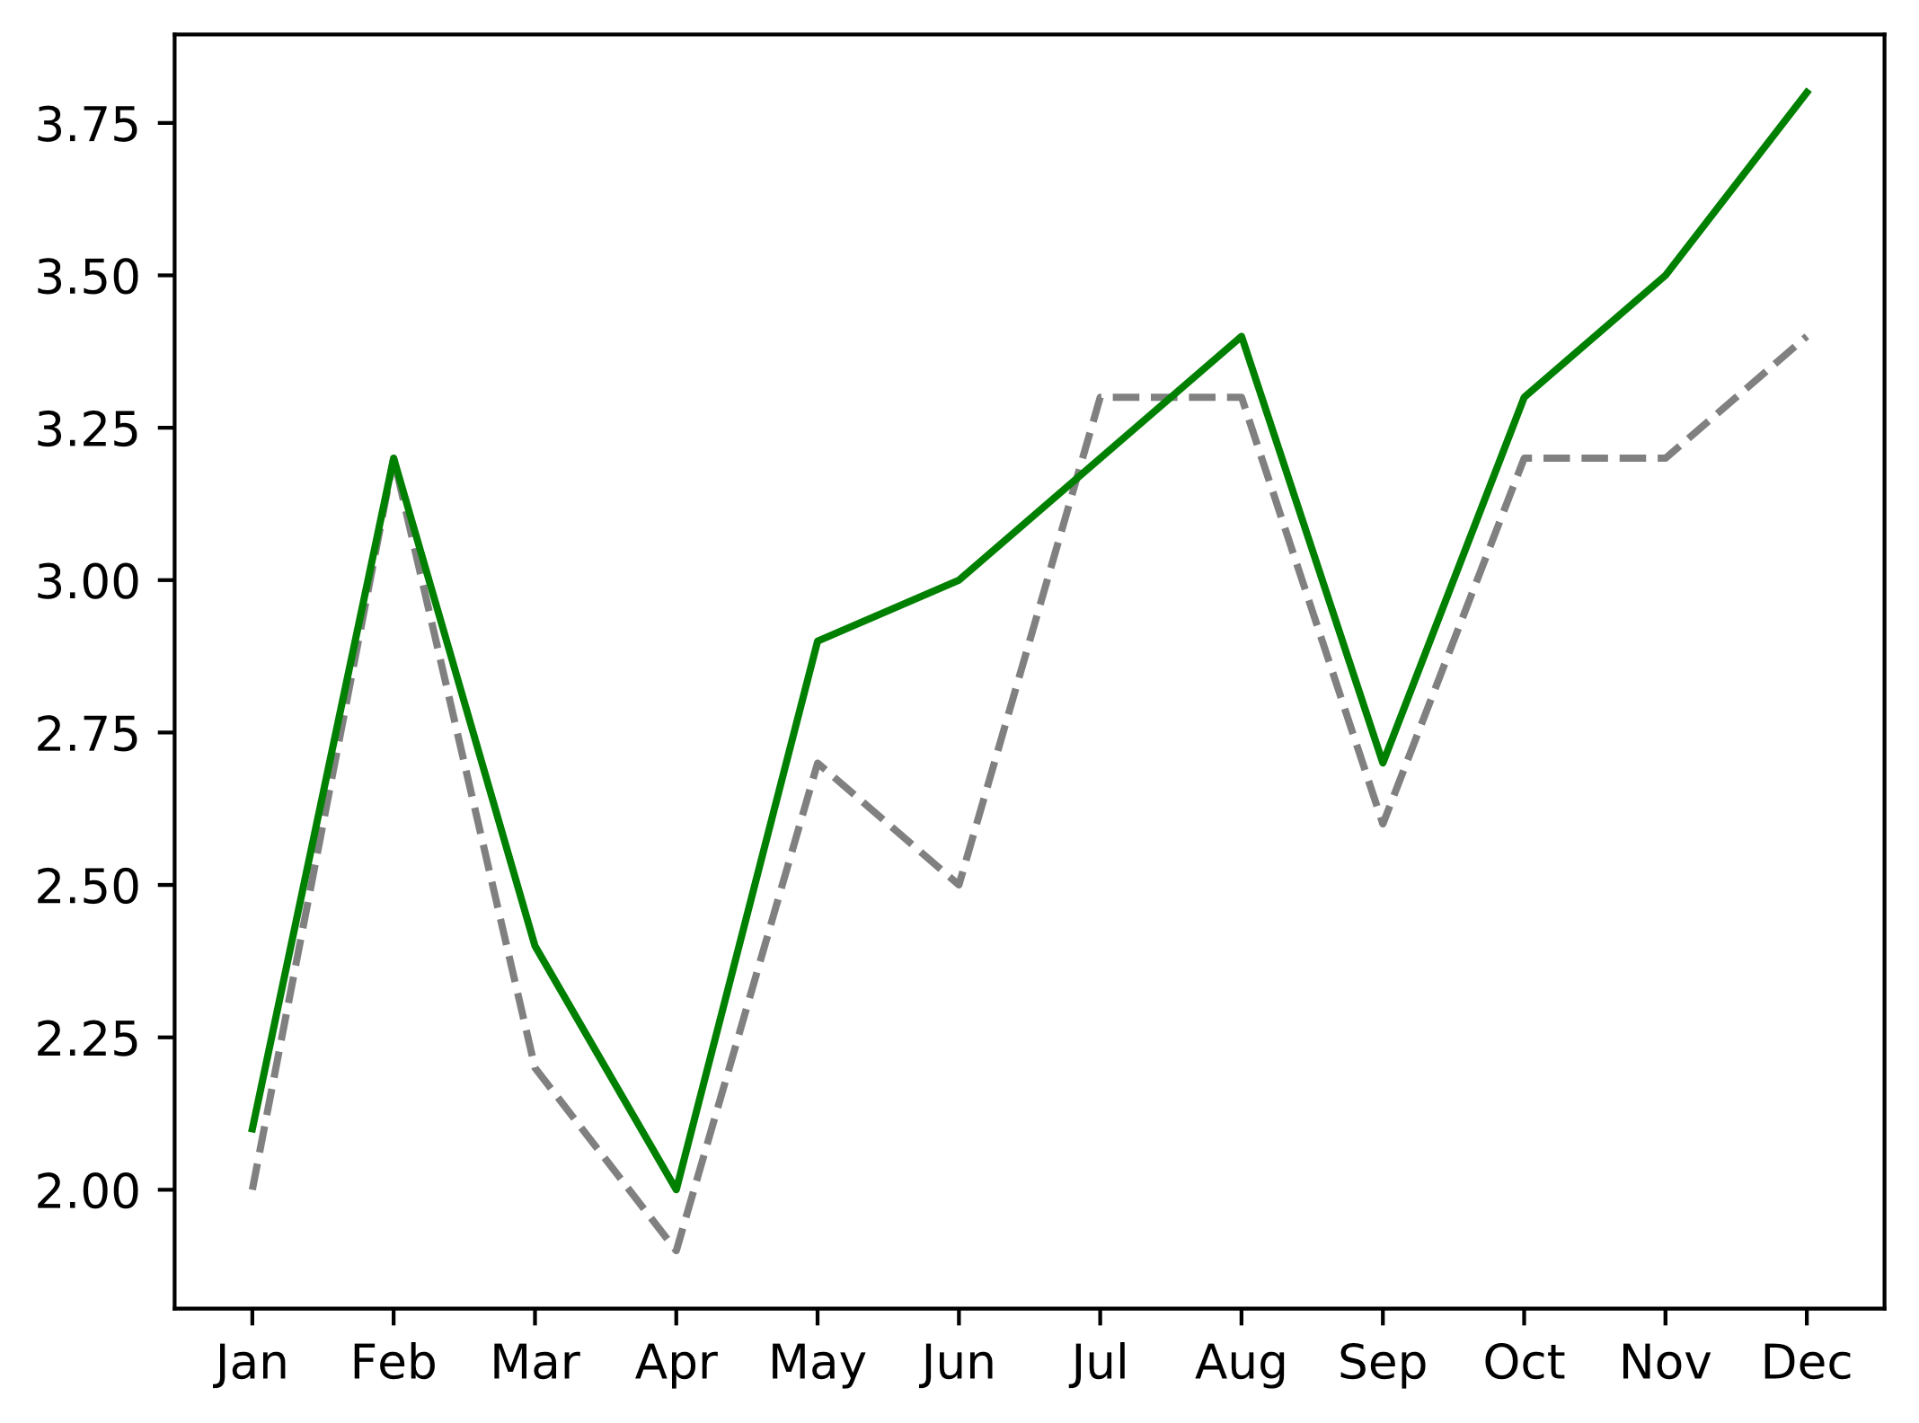
Line Colors and Styles
fig, ax = plt.subplots()
ax.plot(months, slice_2019['Revenue'], c = 'grey', linestyle = 'dashed')
ax.plot(months, slice_2020['Revenue'], c = 'green')
2020
2019

Slide 39
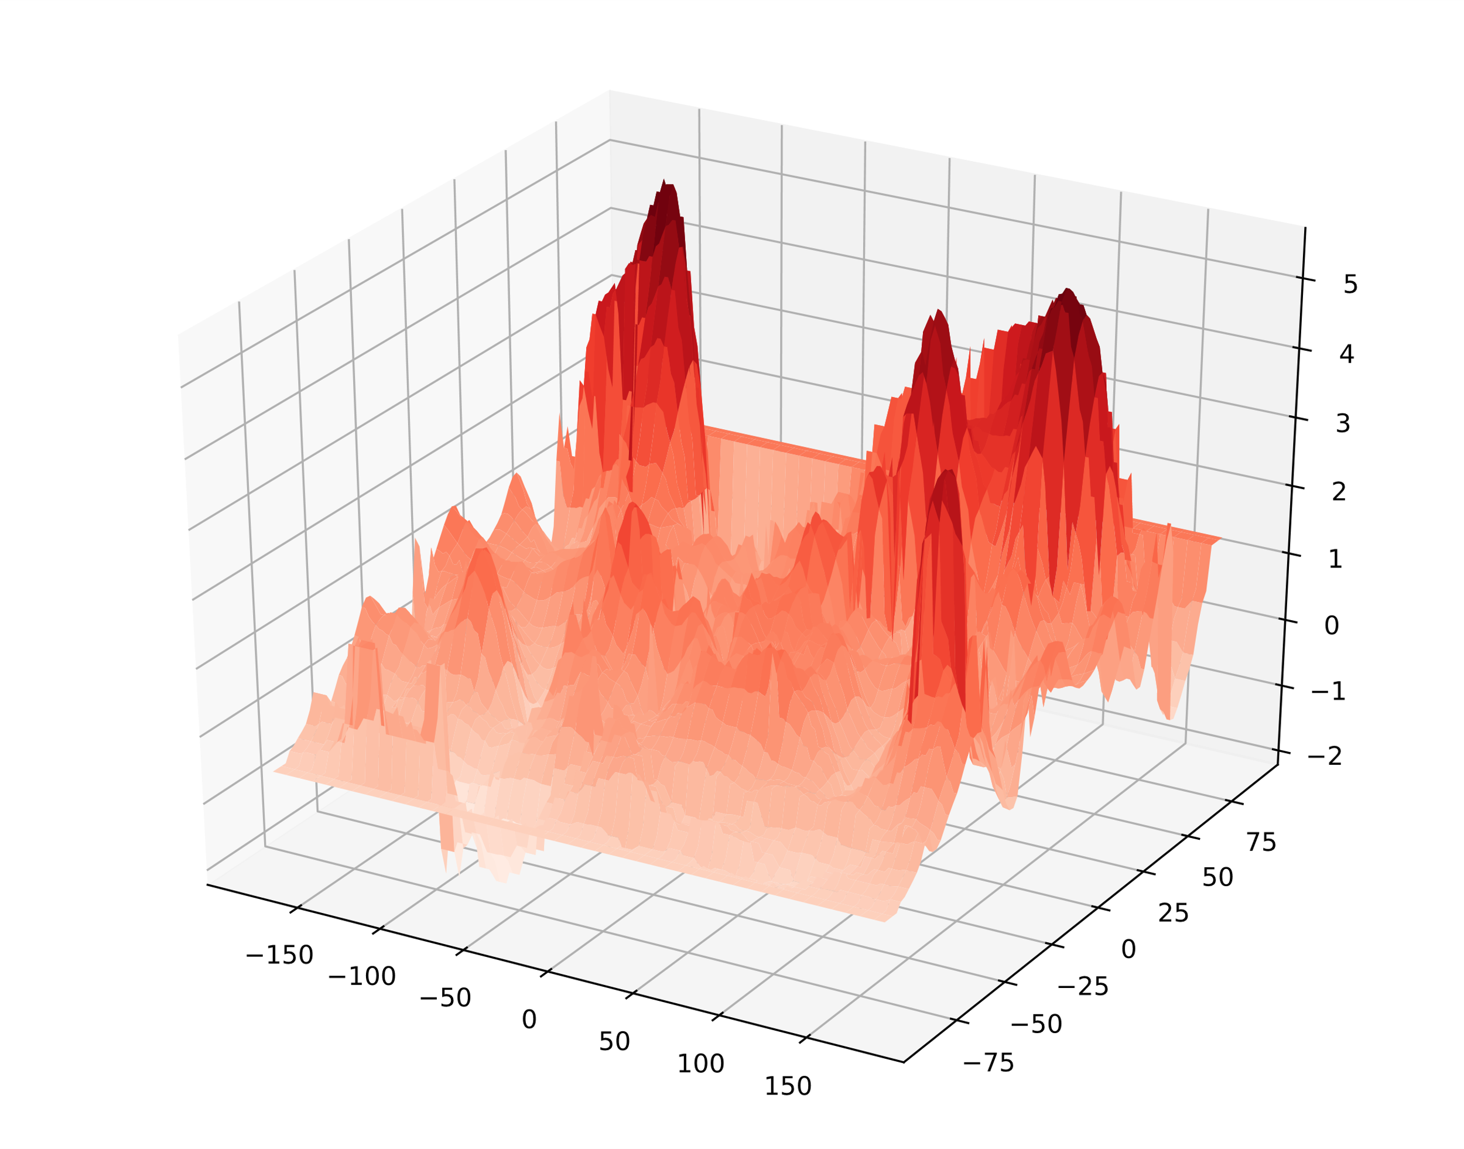
Color Maps
fig = plt.figure()
ax = fig.add_subplot(projection = '3d')
ax.plot_surface(lon_grid, lat_grid, temp_anomaly, cmap = 'Reds')
Temp.
Latitude
Longitude

Slide 40
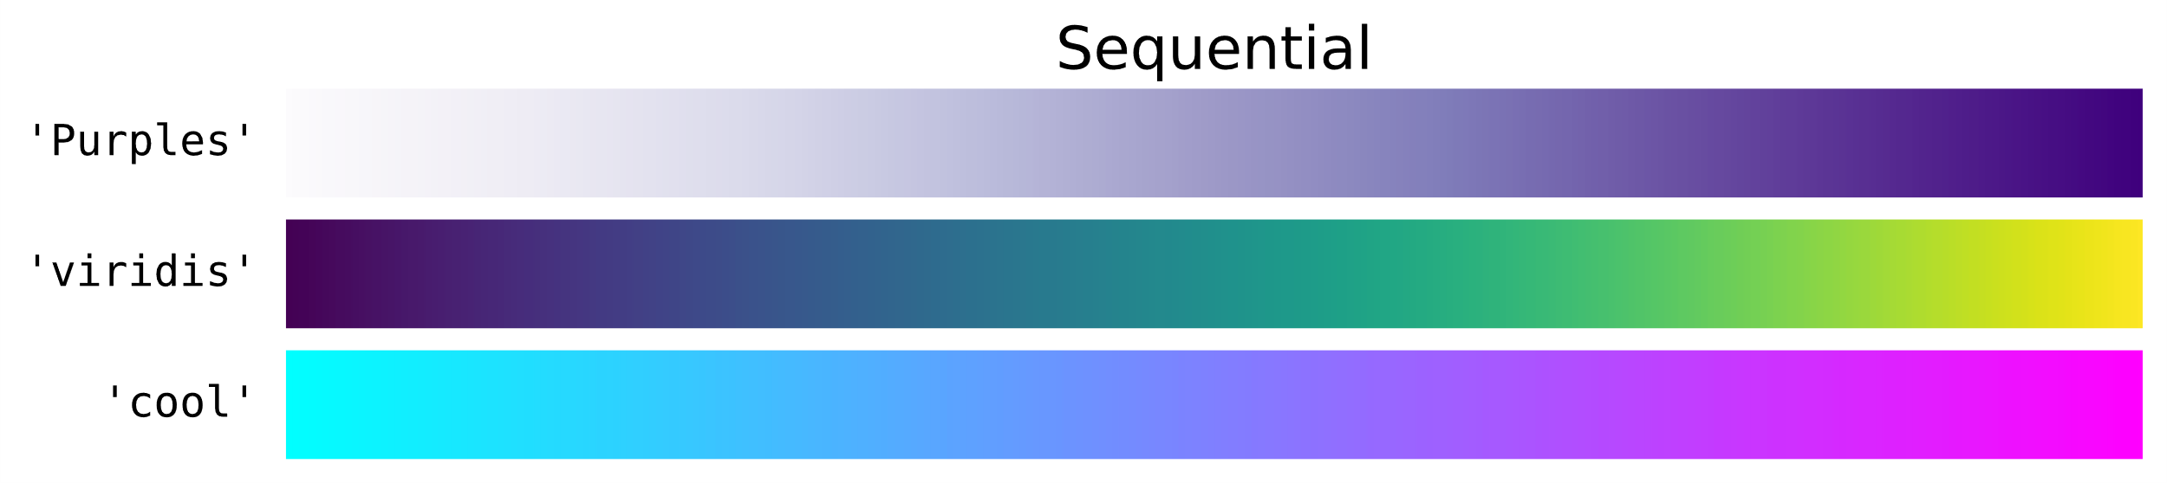
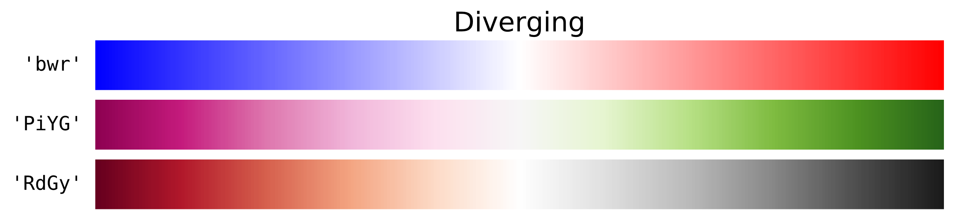
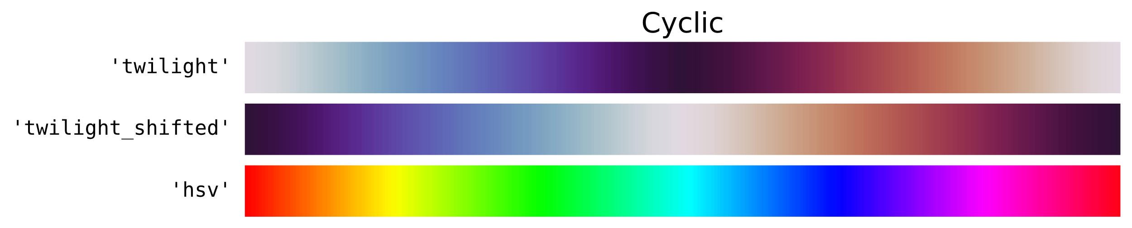
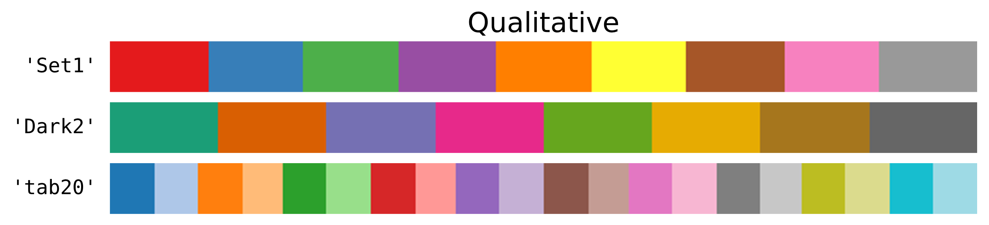
Color Map Selection

Slide 41
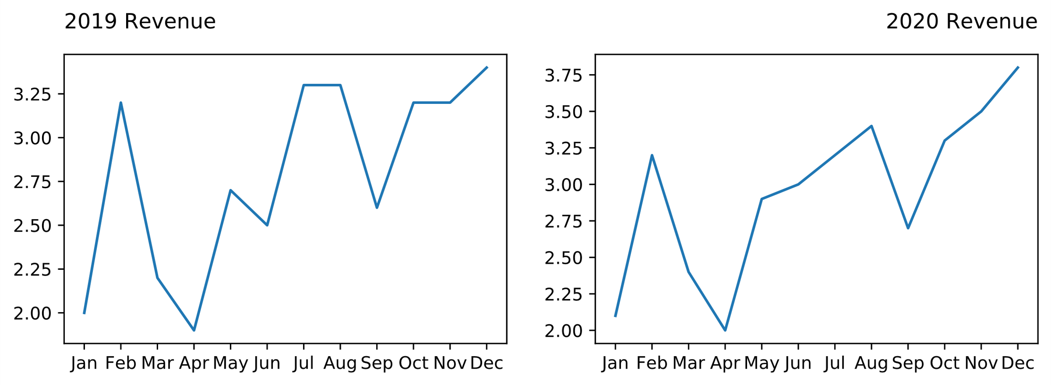
Title Labels (Slide 1 of 2)
... # Plotting code.
ax[0].set_title('2019 Revenue', loc = 'left', pad = 15)
ax[1].set_title('2020 Revenue', loc = 'right', pad = 15)
Left aligned
Padding

Slide 42
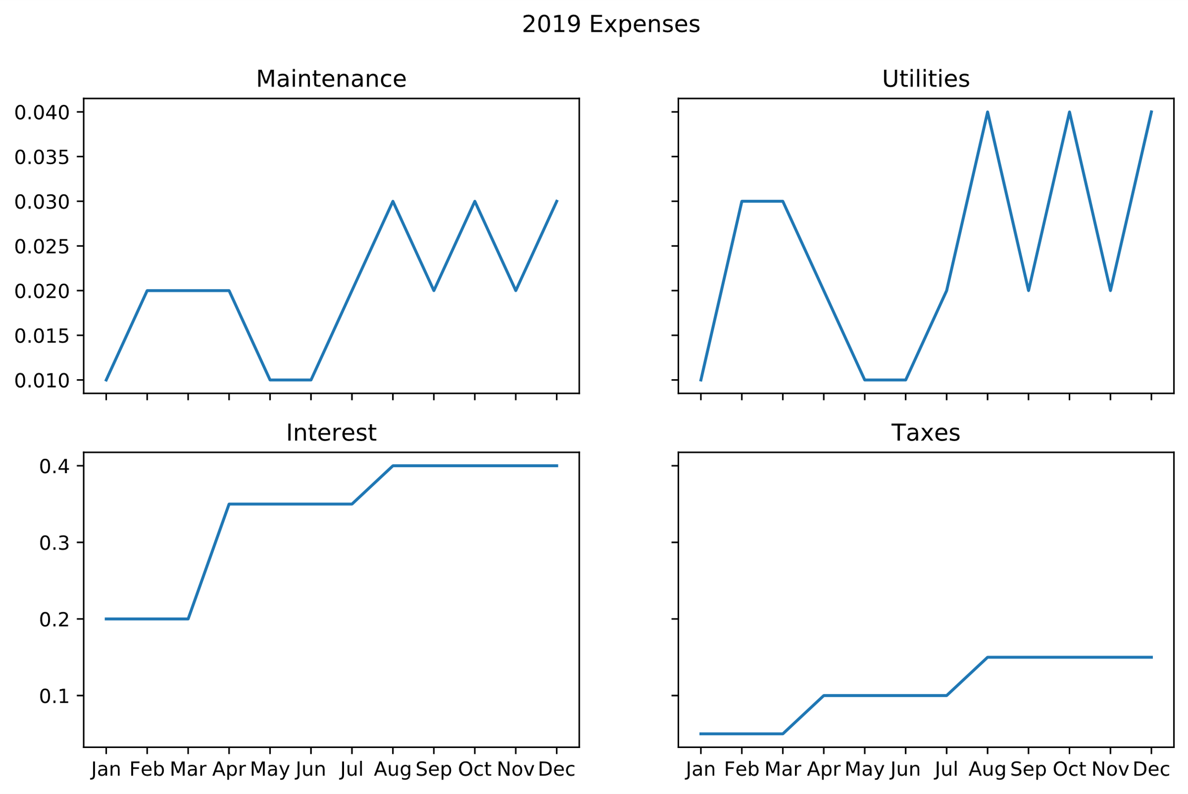
Title Labels (Slide 2 of 2)
fig.suptitle('2019 Expenses')
Super title
Subtitle

Slide 43
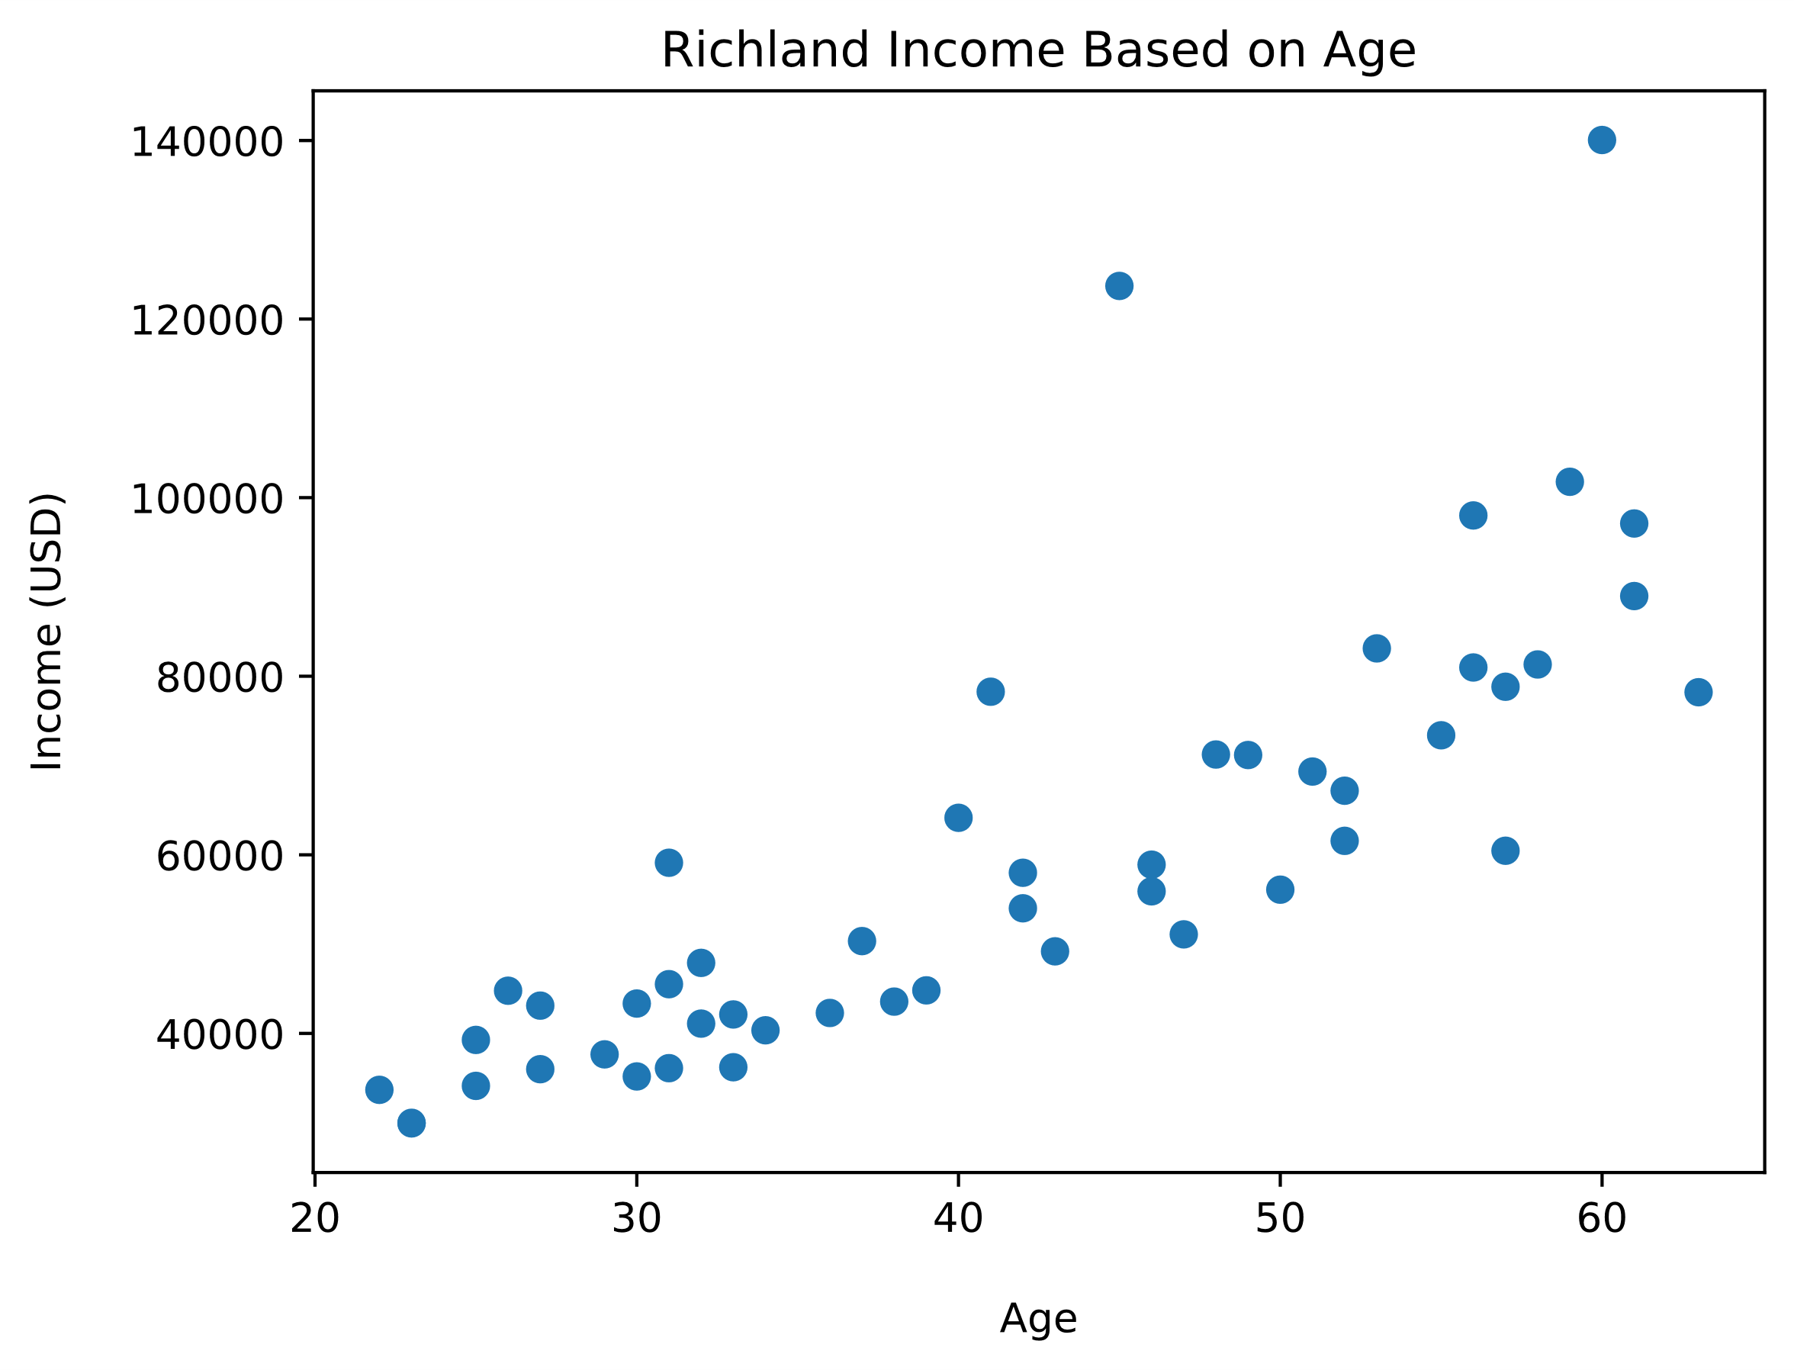
Axis Labels
ax.set_title('Richland Income Based on Age')
ax.set_xlabel('Age', labelpad = 15)
ax.set_ylabel('Income (USD)', labelpad = 15)
Axis label
Padding

Slide 44
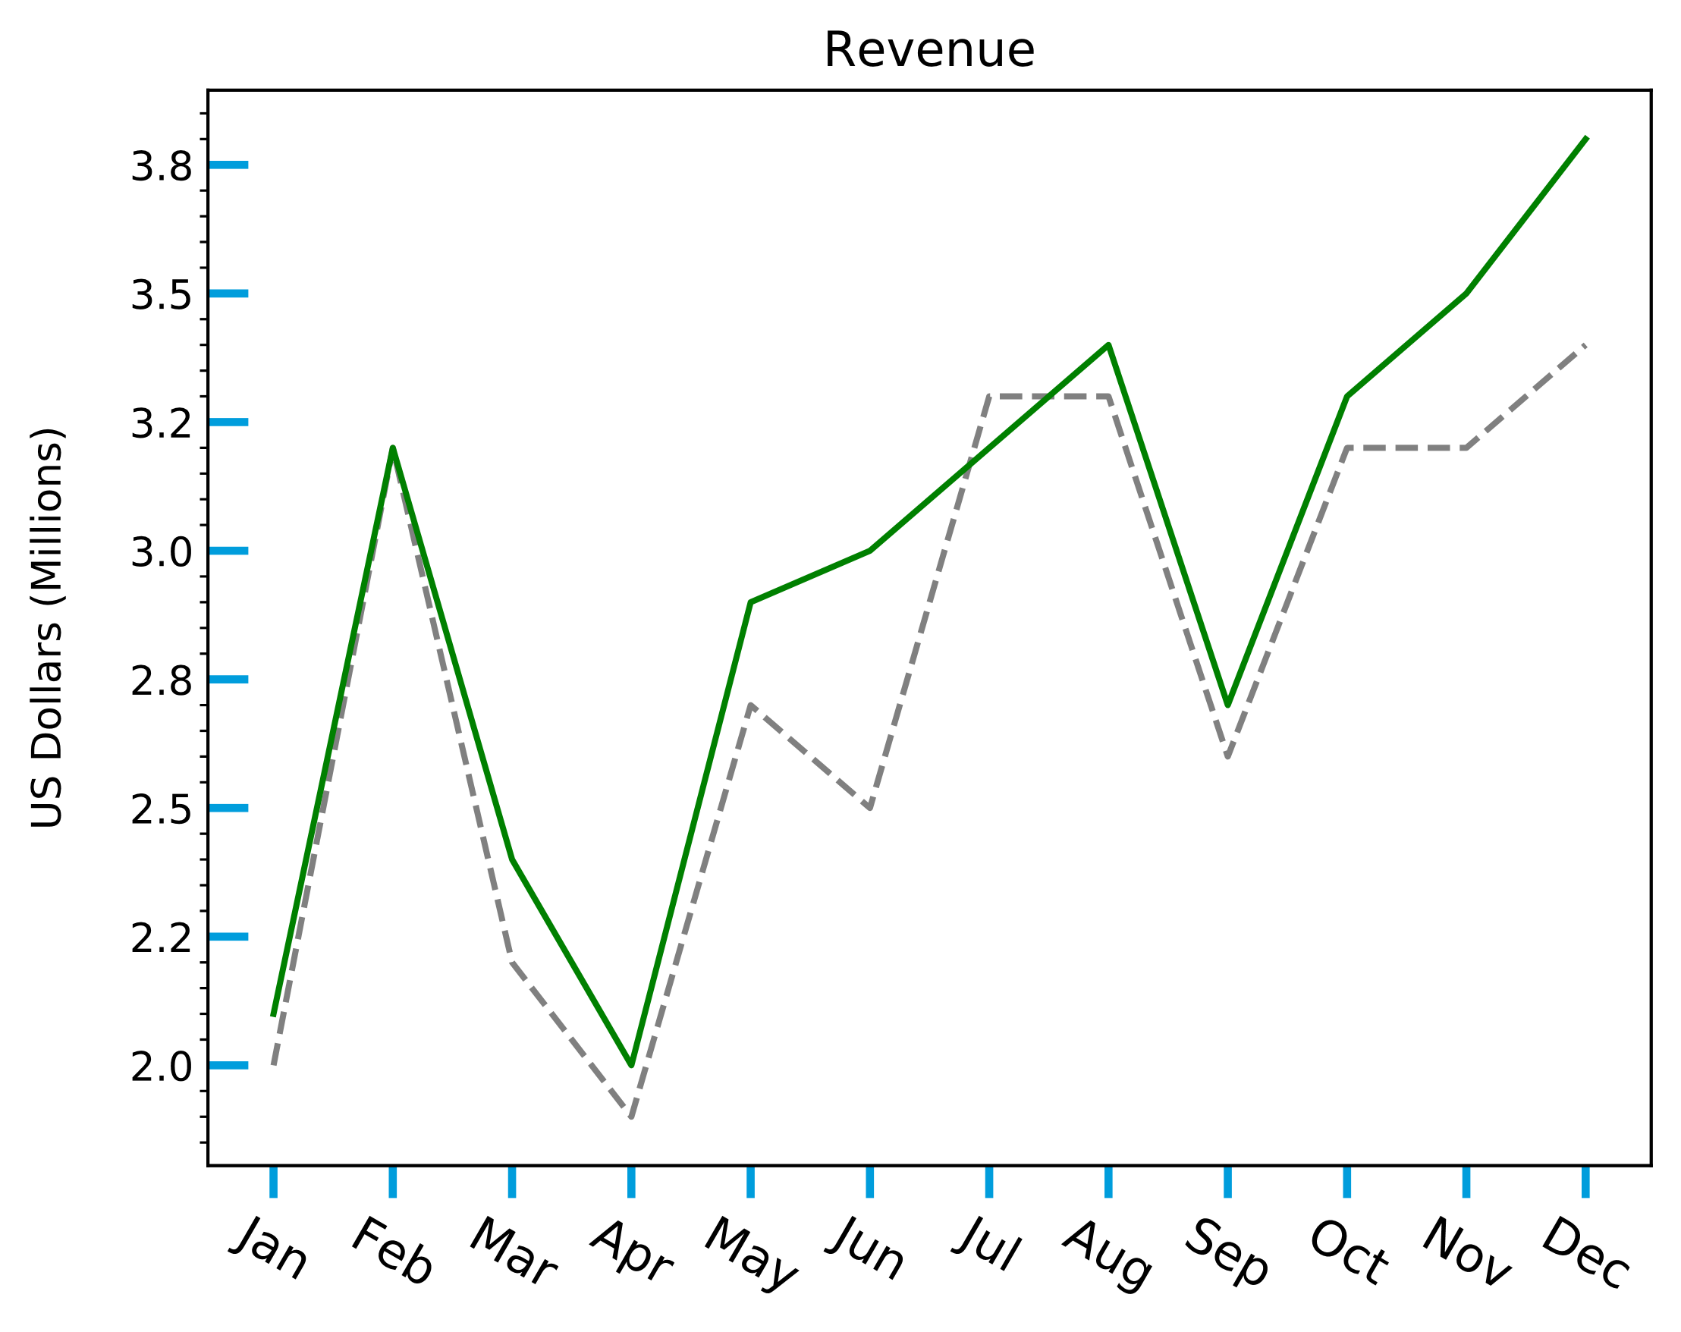
Axis Ticks
ax.tick_params(axis = 'x', direction = 'out', length = 8, width = 2,
color = '#009ddc', labelsize = 12, labelrotation = -30)
ax.tick_params(axis = 'y', direction = 'in', length = 10, width = 2,
color = '#009ddc')
Inside ticks
Rotated labels

Slide 45
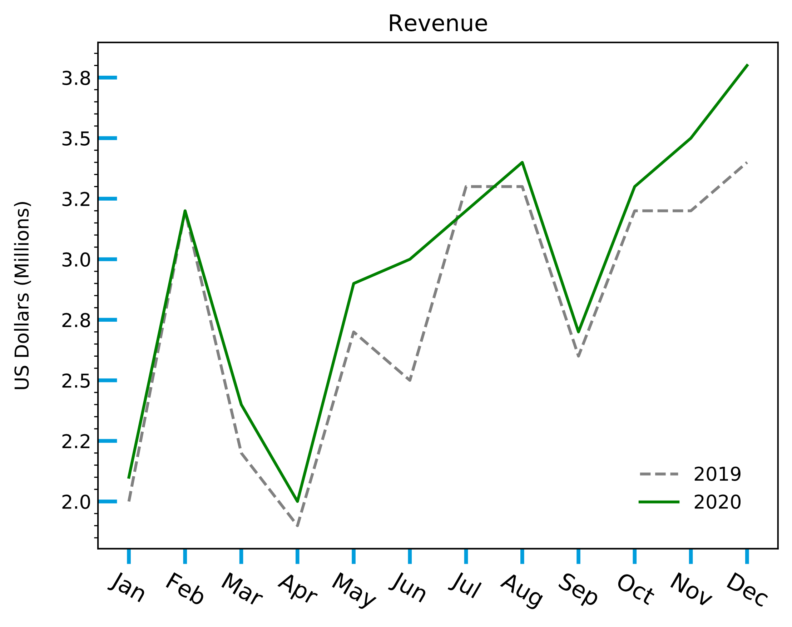
Legends
ax.legend(loc = 'lower right', frameon = False, borderaxespad = 1.5)
Legend

Slide 46
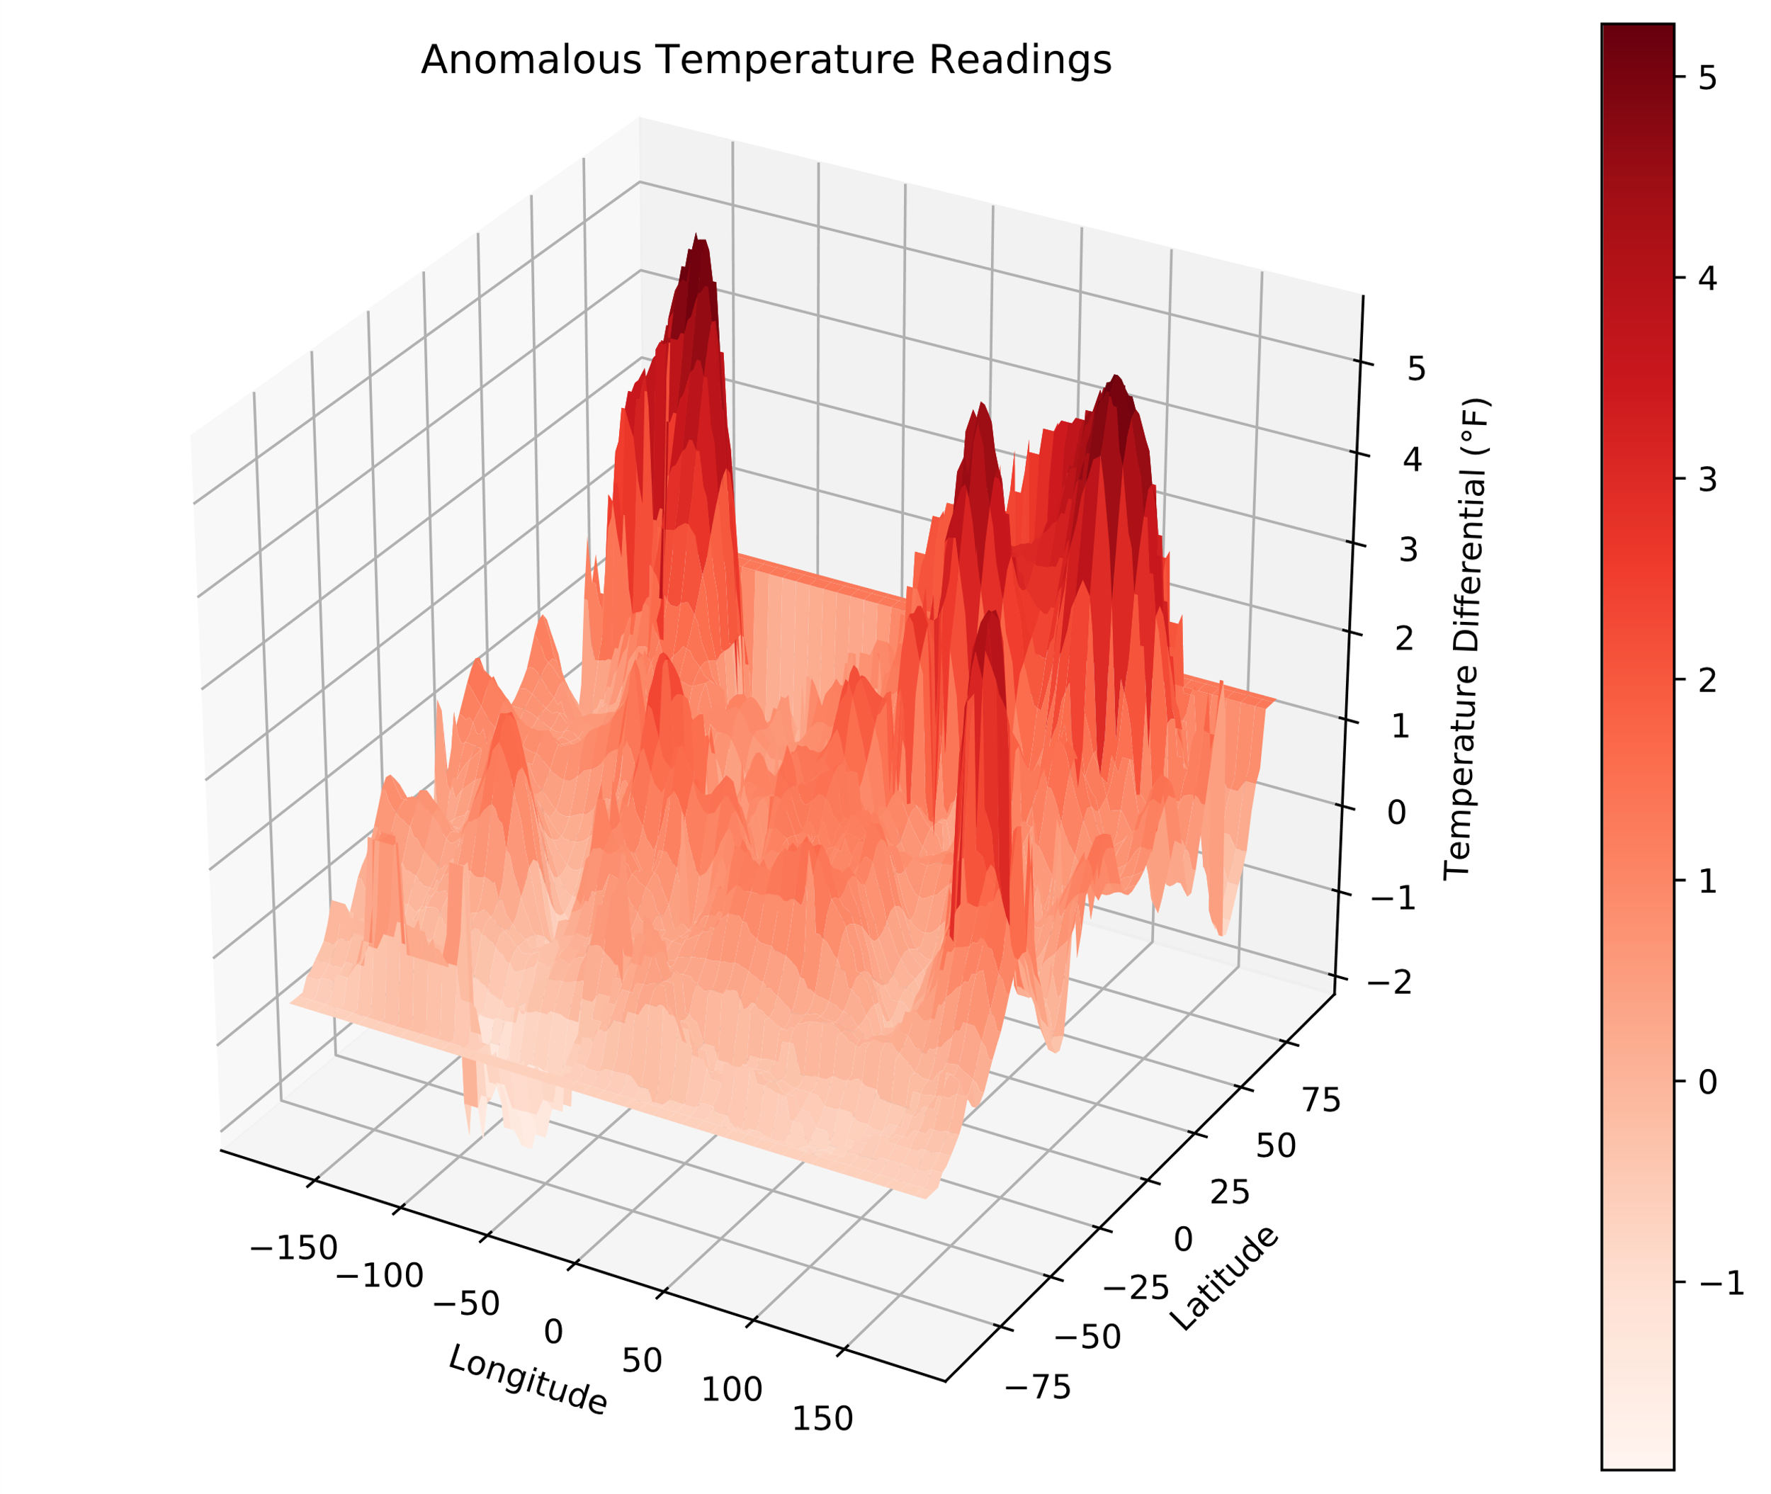
Color Bars
plot = ax.plot_surface(lon_grid, lat_grid, temp_anomaly, cmap = 'Reds')
fig.colorbar(plot)
Color bar axis

Slide 47
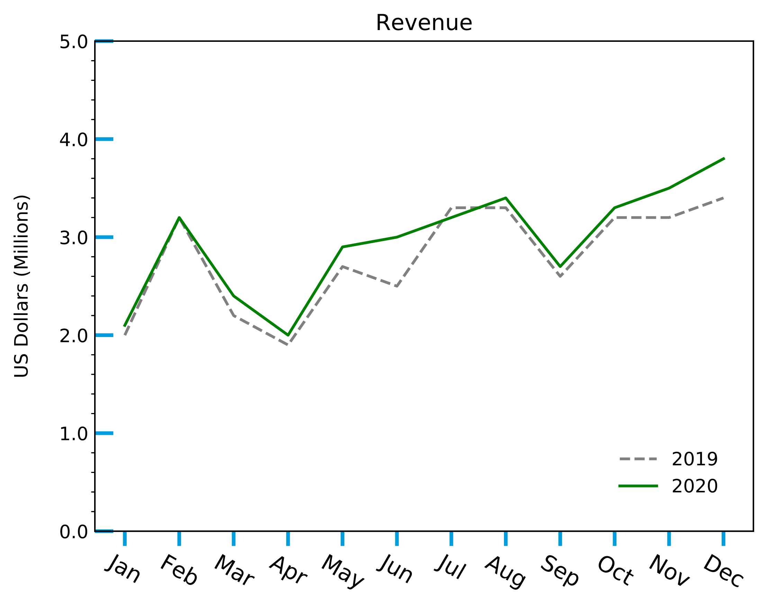
Axis Limits
ax.set_ylim(bottom = 0, top = 5)
New upper bound
New lower bound

Slide 48
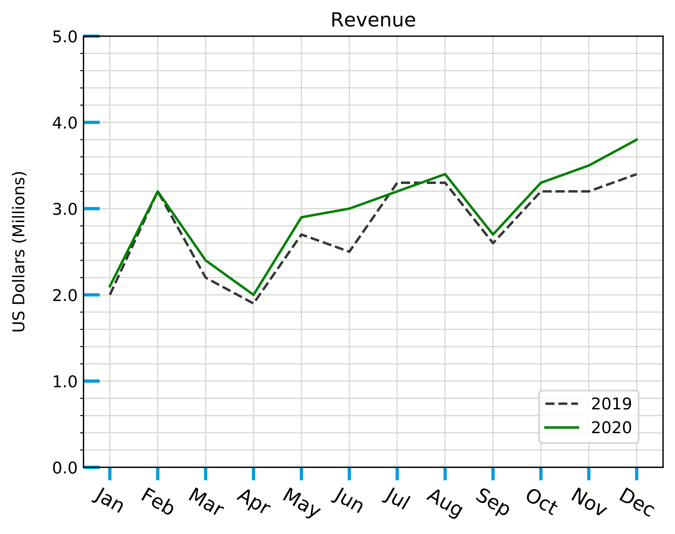
Grids
ax.grid(which = 'both', axis = 'both', color = '#d8dcd6')
Minor grid lines

Slide 49
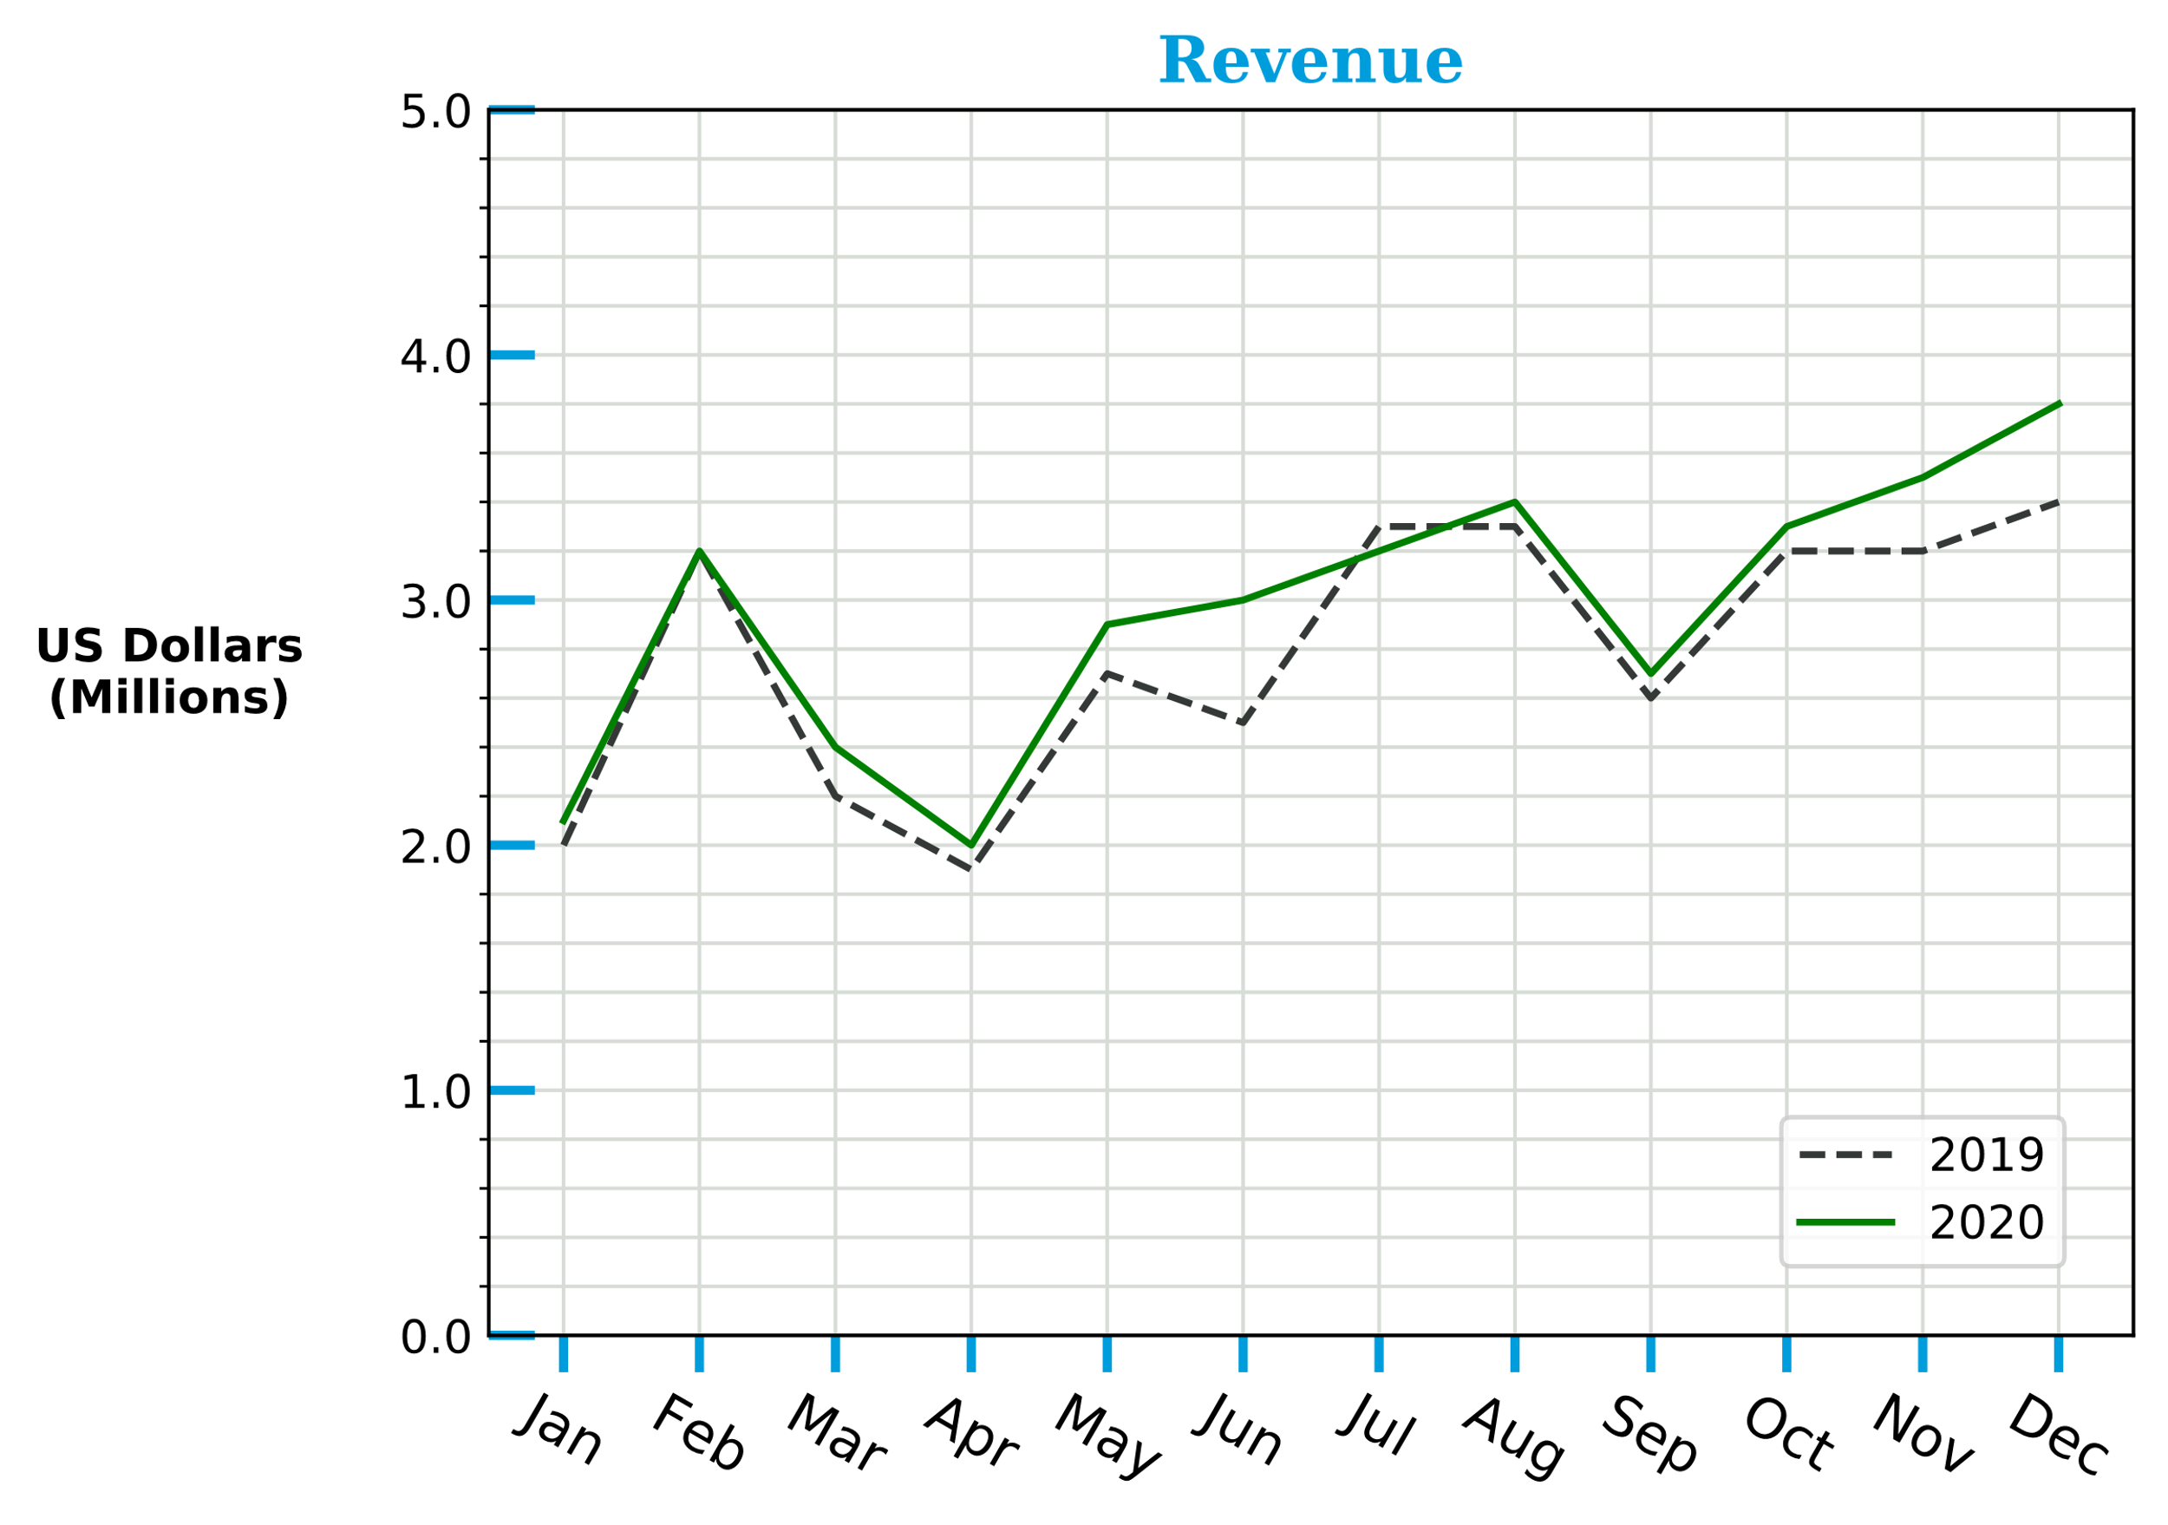
Text Properties
ax.set_title('Revenue', color = '#009ddc', size = 14,
weight = 'bold', family = 'serif')
ax.set_ylabel('US Dollars\n(Millions)', labelpad = 50,
rotation = 'horizontal', weight = 'bold')
Blue, 14 pt., serif
Bold, horizontal

Slide 50
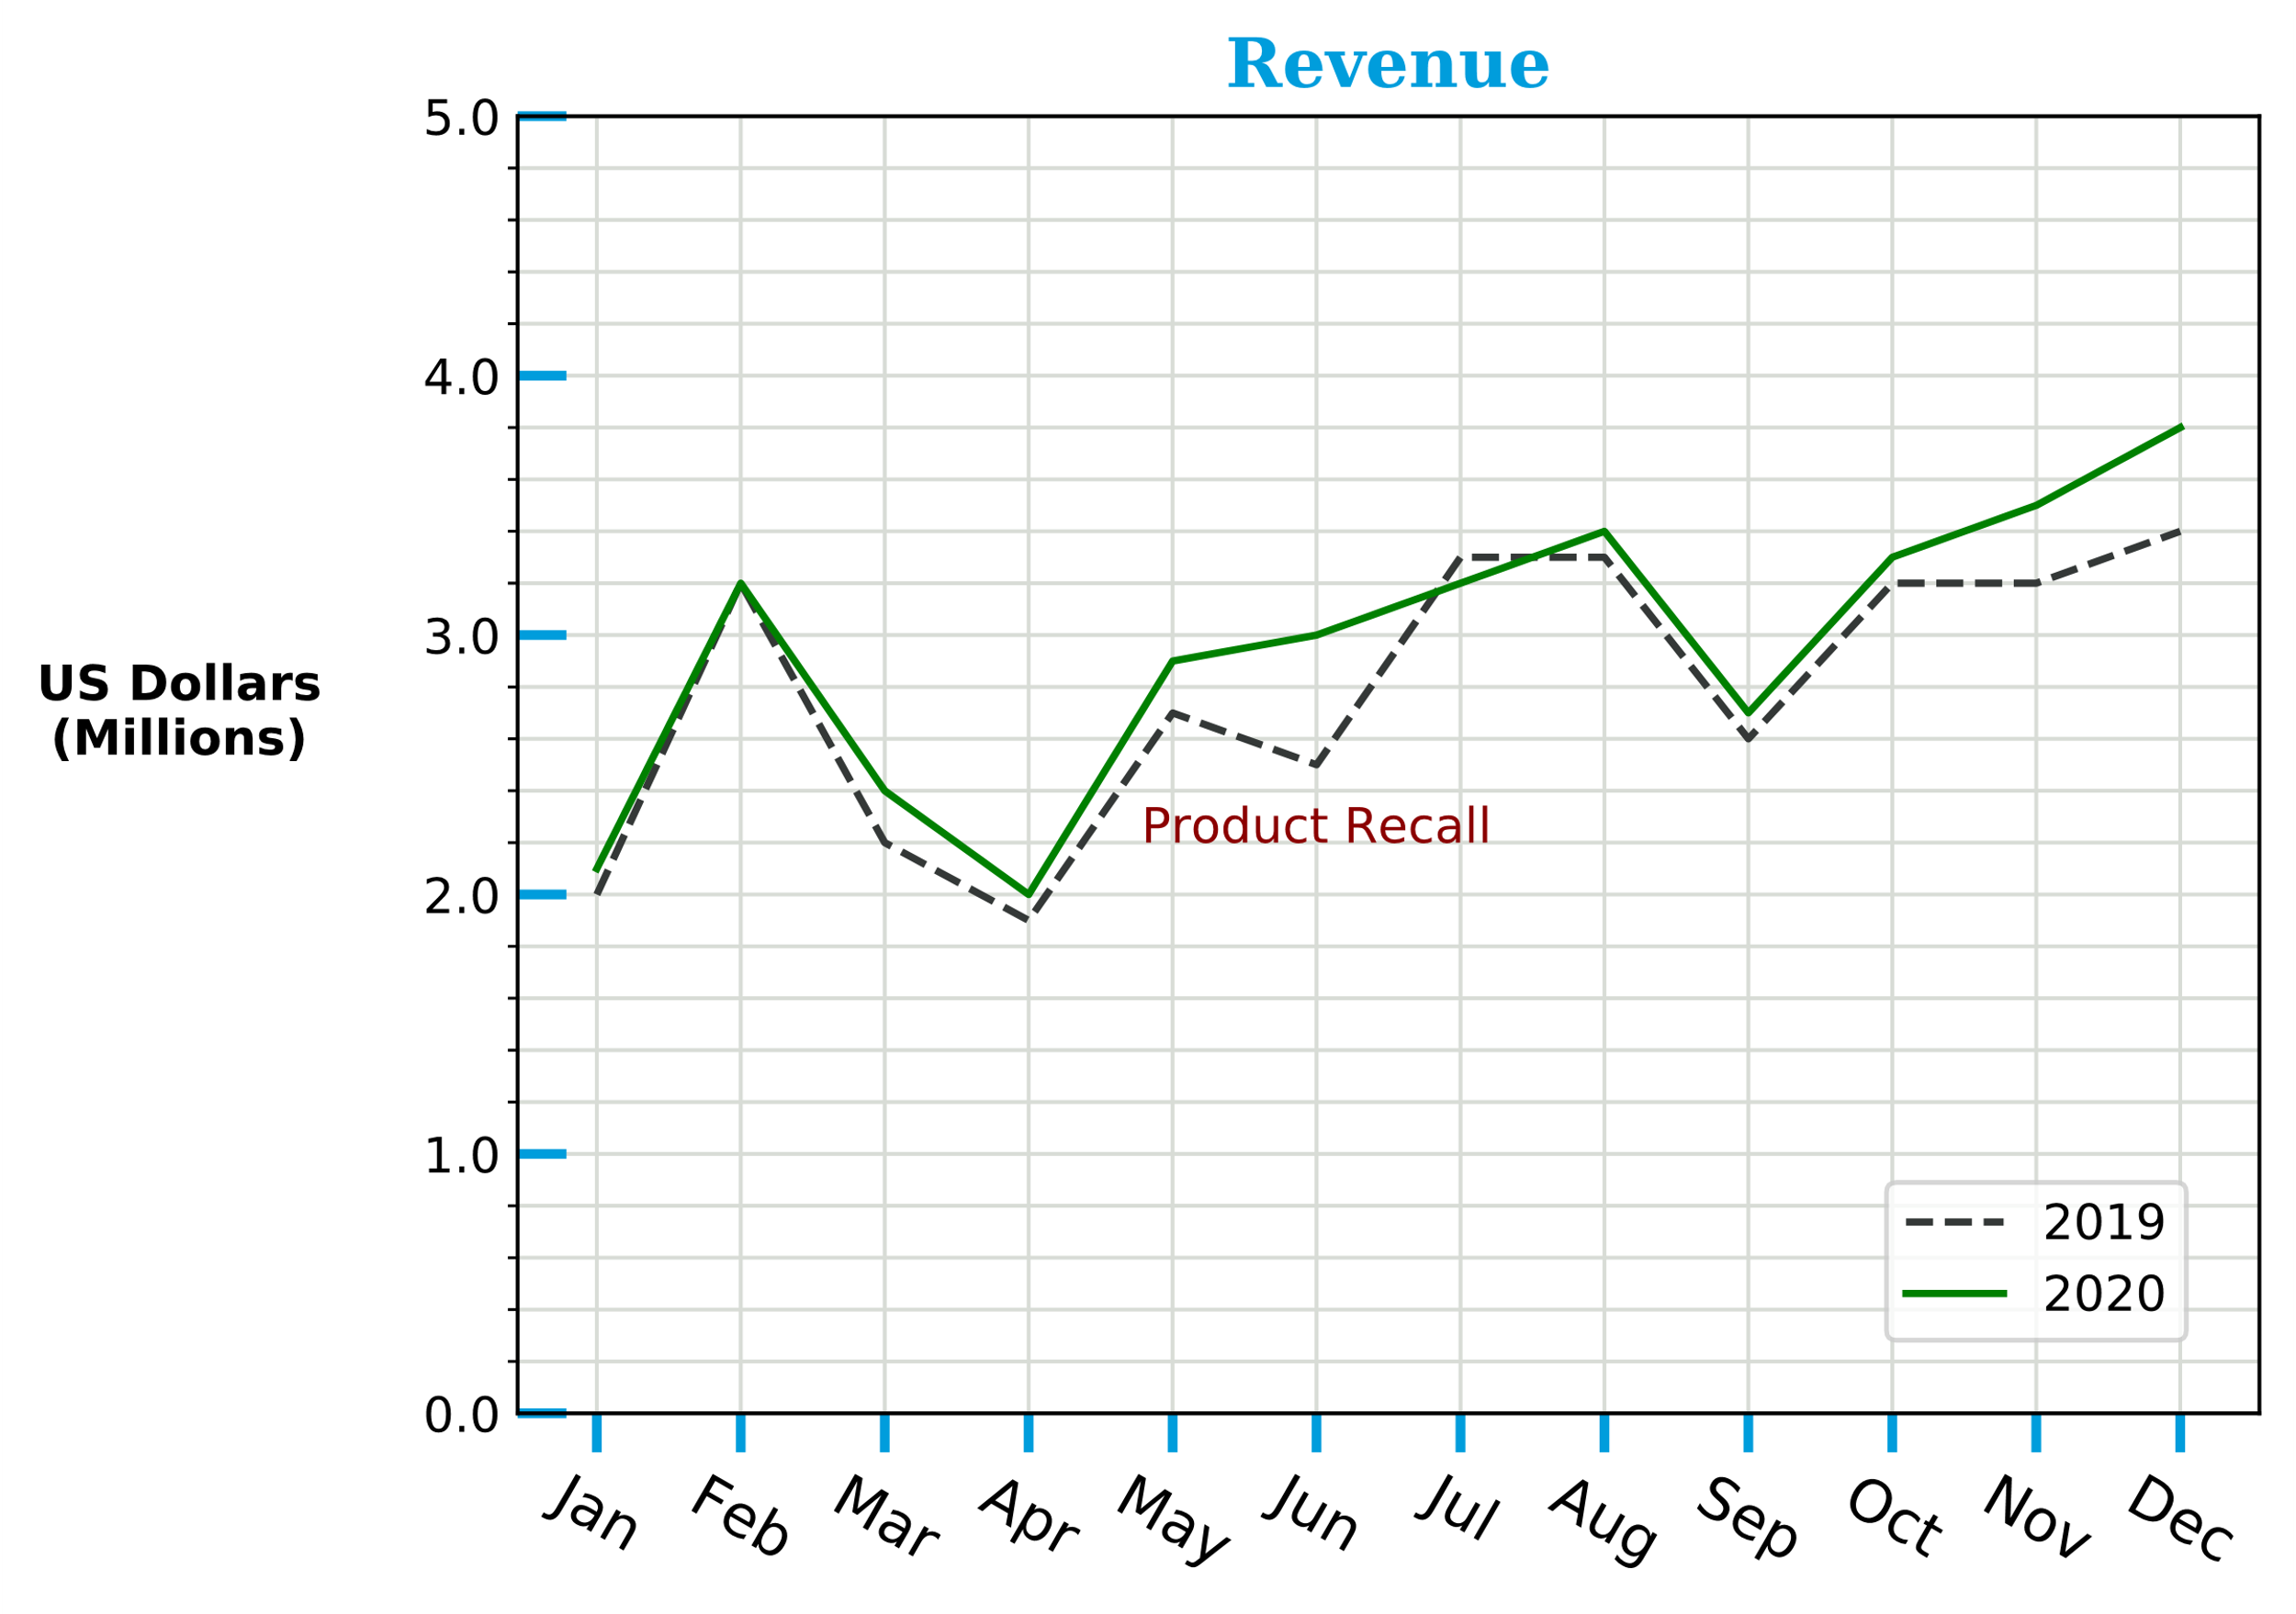
Annotation (Slide 1 of 2)
ax.text(x = 'Jun', y = 2.2, s = 'Product Recall',
horizontalalignment = 'center', color = 'darkred')

Slide 51
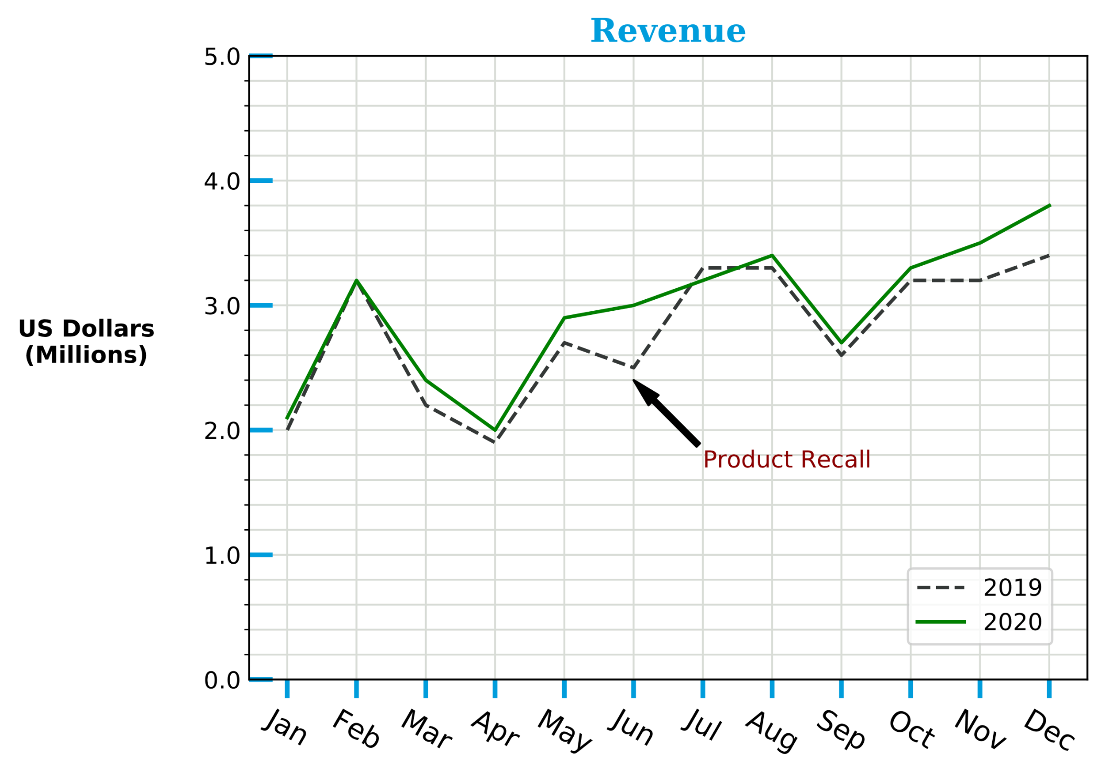
Annotation (Slide 2 of 2)
arrow_format = {'color': 'black', 'width': 2, 'headwidth': 6}
ax.annotate('Product Recall', xy = ('Jun', 2.4),
xytext = ('Jul', 1.7), arrowprops = arrow_format, color = 'darkred')

Slide 52
Stateful vs. Object-Oriented Function Differences
Stateful Function | Object-Oriented Function
pyplot.title() | Axes.set_title()
pyplot.xlabel() | Axes.set_xlabel()
pyplot.ylabel() | Axes.set_ylabel()
pyplot.xlim() | Axes.set_xlim()
pyplot.ylim() | Axes.set_ylim()

Slide 53
The Axes.set() Function
A shortcut for setting multiple formatting elements.
Takes one or more arguments related to a "set" function.
Rather than call each individually:
ax.set_title('Revenue')
ax.set_ylabel('US Dollars\n(Millions)')
ax.set_ylim((0, 5))
Call set() once:
ax.set(title = 'Revenue', ylabel = 'US Dollars\n(Millions)', ylim = (0, 5))
May be better to call specific function if you need to pass in multiple arguments.

Slide 54
Guidelines for Formatting Plots (Slide 1 of 2)
Use style.use() to set an overall style.
Change styles and colors of plot elements to emphasize certain portions.
Consider using colors that support people with color blindness.
Use color maps to demonstrate gradual changes in values.
Choose a color map that best supports the data:
Sequential for data with a natural order.
Diverging for data with a prominent middle.
Cyclic for data that wraps.
Qualitative for categorical data.
Apply title labels to explain the purpose of a plot or subplot.
Apply axis labels to indicate that variable the axis represents.
Consider omitting if it's obvious.

Slide 55
Guidelines for Formatting Plots (Slide 2 of 2)
Consider customizing tick appearance and labels.
Add legends and color bars to add needed context.
Consider adjusting axis limits to change scale.
Consider adding grids to plots for easier tracing of data points.
Adjust text formatting to emphasize certain labels.
Consider adding an annotation if something needs to be called out.
Avoid cluttering plots with excess annotations or other elements.
Use Axes.set() to set multiple formatting options in one statement.

Slide 56
Activity: Formatting Plots
You need to think about how to format plots so they're easier to interpret.
Formatting will provide necessary context for your audience.
You want to present two visuals to business leaders:
Line graph showing day-by-day revenue for January and February.
Scatter plots showing how key attributes affect gross income.
You'll make these visuals presentable using formatting.

Slide 57
Streamline Plotting with Seaborn
Topic E

Slide 58
Seaborn vs. Matplotlib
Matplotlib shortcomings:
Detail configuration can be tedious.
No full support for pandas structures.
Not always aesthetically pleasing.
Seaborn addresses these downsides.
High-level interface into Matplotlib.
Minimizes tedium of plot configuration.
Uses pandas structures intelligently.
Creates plots that tend to look nicer.

Slide 59
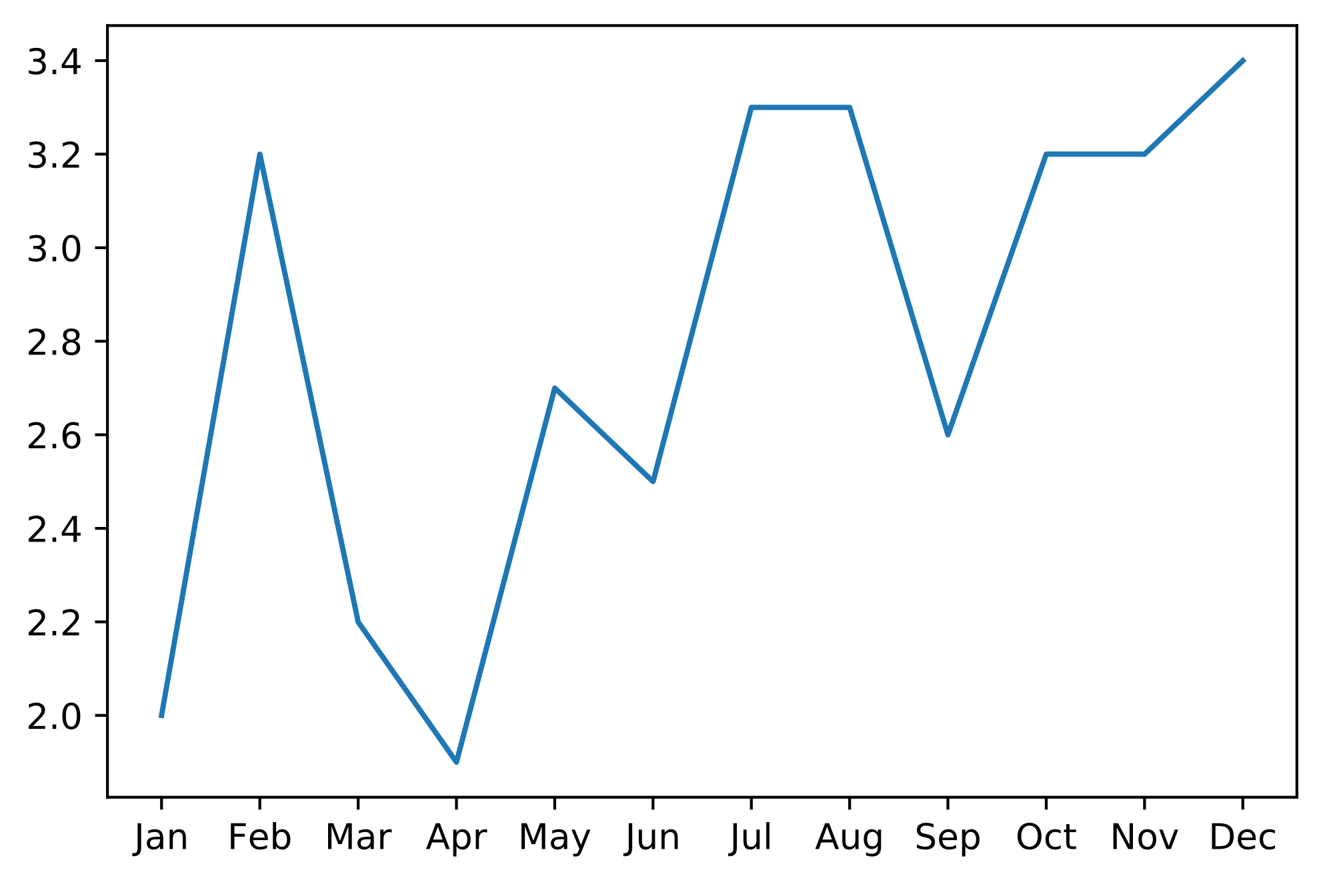
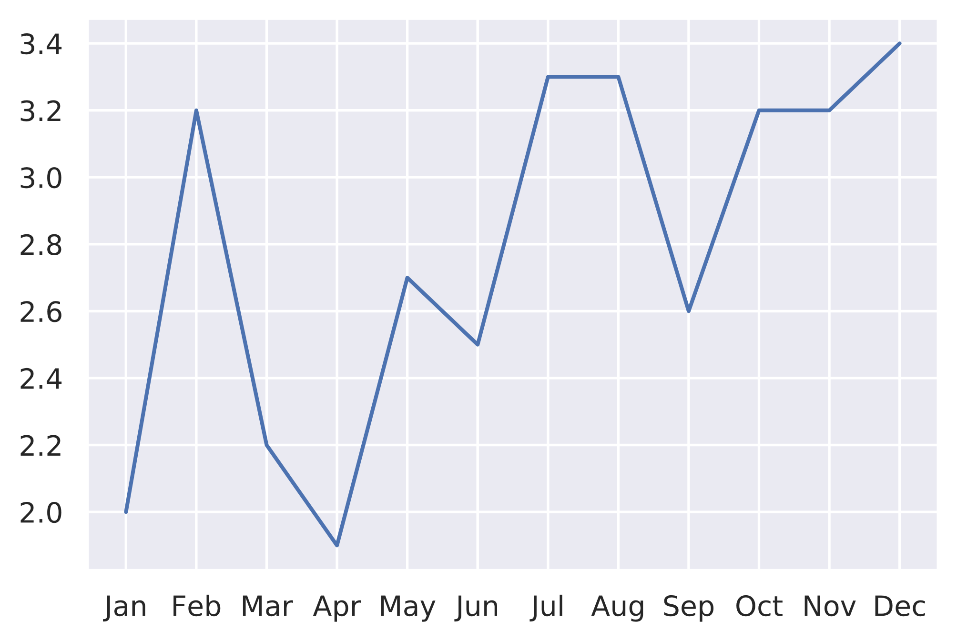
Integration with Matplotlib
fig, ax = plt.subplots()
ax.plot(months, slice_2019['Revenue'])
seaborn.set()
fig, ax = plt.subplots()
ax.plot(months, slice_2019['Revenue'])
Matplotlib
Seaborn

Slide 60
The seaborn.set() Function
Initializes look and feel of Seaborn plots.
Overrides Matplotlib styles and parameters.
Customize using various arguments:
style —Style for axes.
palette —Color palette.
font —Font family.
rc —Runtime configuration parameters.
More common to call functions that set formatting options directly.
Use seaborn.set() with no arguments to reset visuals to default.

Slide 61
The seaborn.set_style() Function
Sets overall style of plot.
Styles:
'darkgrid' —Grid with gray background.
'whitegrid' —Grid with white background.
'dark' —No grid with gray background.
'white' —No grid with white background.
'ticks' —Adds tick marks and has white background.
Simple way to set look and feel of plots.
All plots after this call will adopt style unless you reset it.

Slide 62
The seaborn.axes_style() Function (Slide 1 of 2)
More flexible than seaborn.set_style().
You can override specific parameters in each of the five styles.
Supply dictionary to rc argument:
seaborn.axes_style('dark', {'xtick.bottom': True, 'ytick.left': True})
Sets styles temporarily.
Plots you want to adopt style go inside a with statement:
fig = plt.figure(figsize = (13, 10))
with seaborn.axes_style('darkgrid'):
ax = fig.add_subplot(2, 2, 1)
ax.plot(months, slice_2019['Revenue'])
with seaborn.axes_style('whitegrid'):
ax = fig.add_subplot(2, 2, 2)
ax.plot(months, slice_2019['Revenue'])
... # More plots.

Slide 63
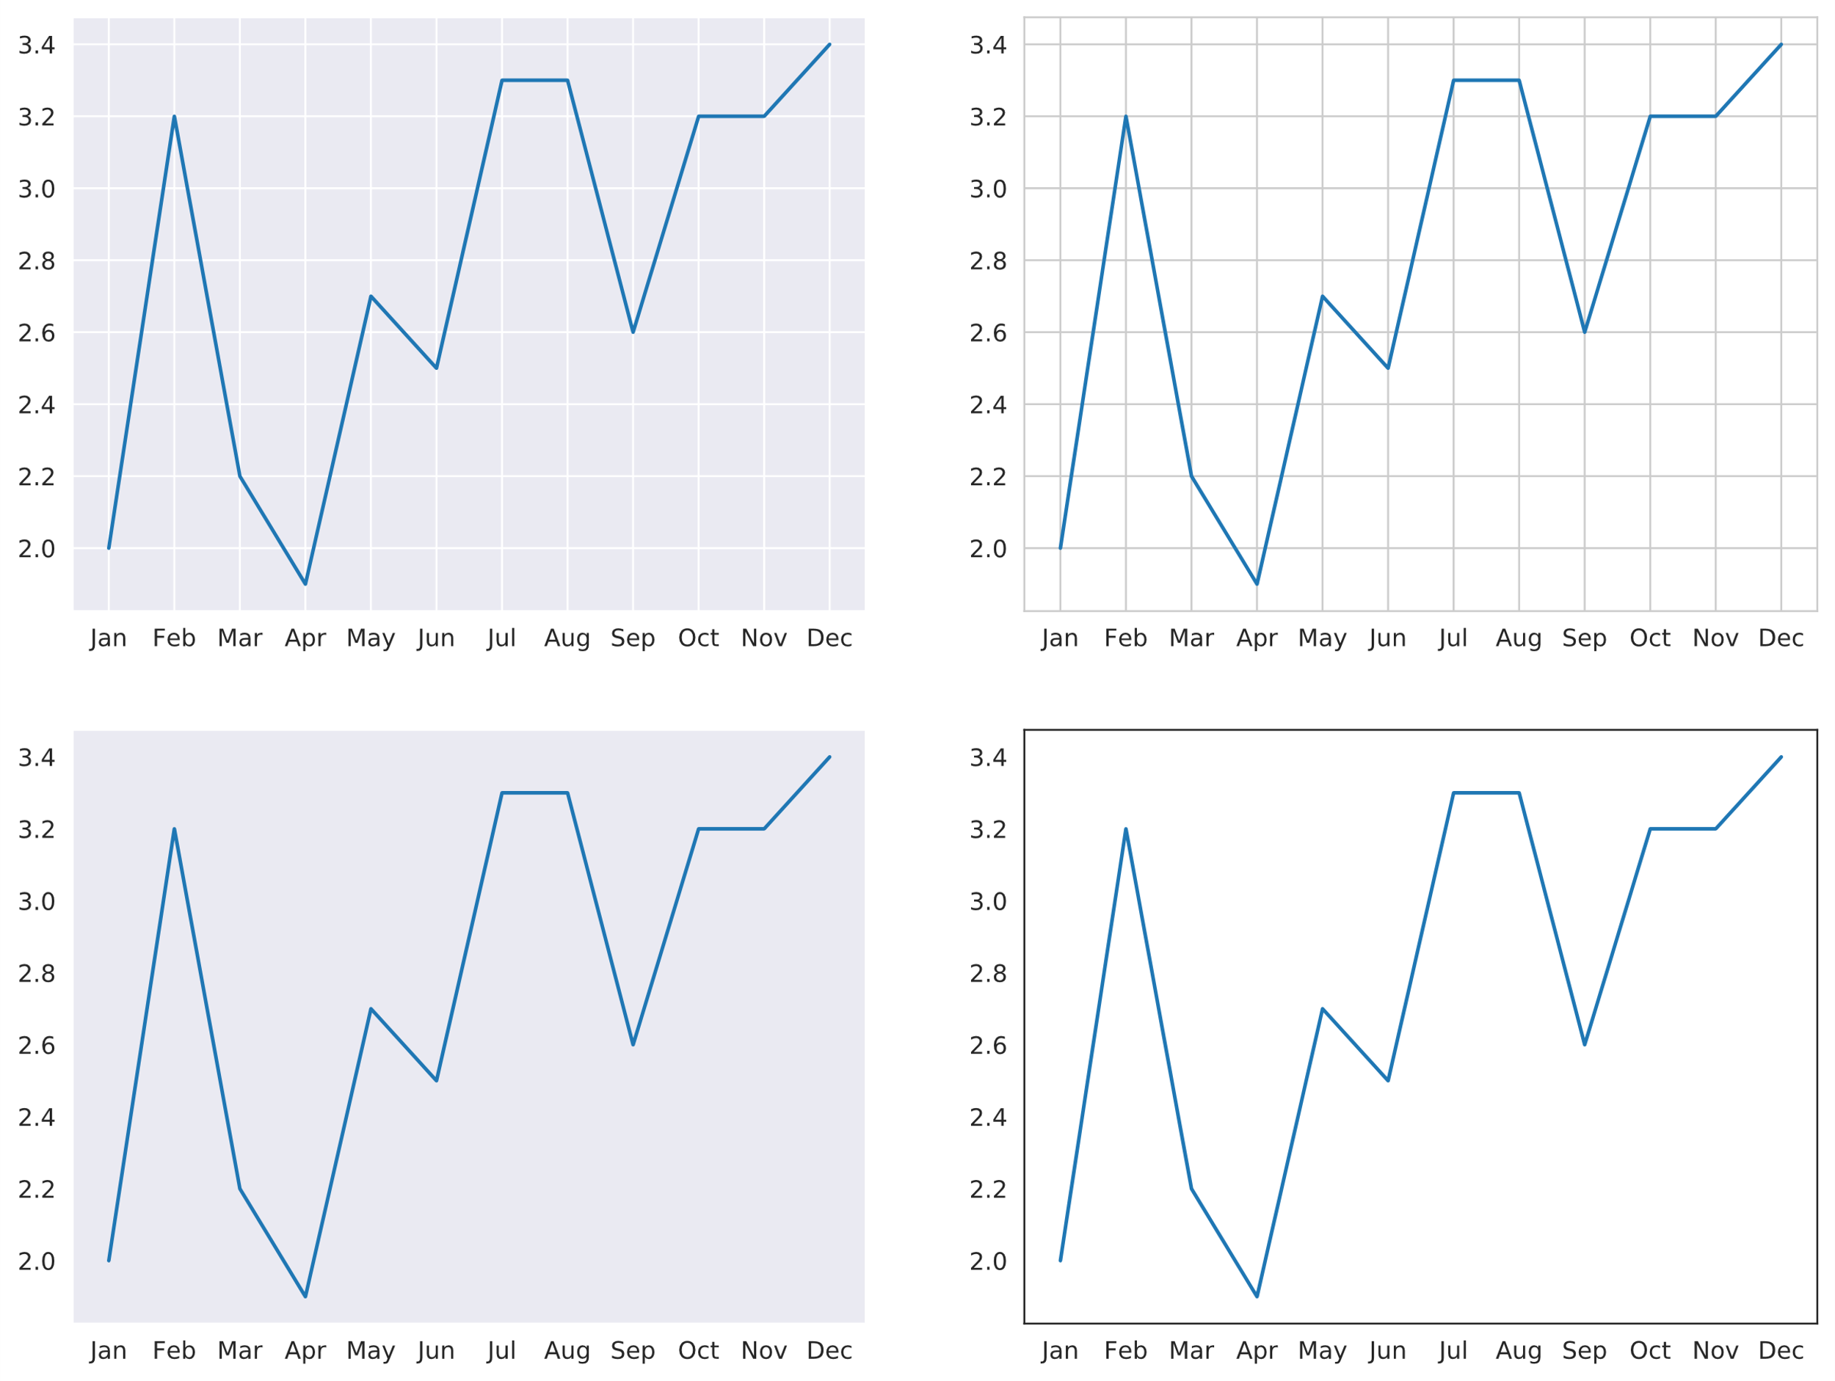
The seaborn.axes_style() Function (Slide 2 of 2)
'darkgrid'
'whitegrid'
'dark'
'white'

Slide 64
The seaborn.color_palette() Function (Slide 1 of 2)
Retrieves and configures color palettes.
Arguments:
palette —Name of palette.
n_colors —Number of colors to use.
desat —Amount to desaturate palette by.
Palettes use different tones of same colors.
You can use Matplotlib color maps as well.
Example:
with seaborn.color_palette('dark'):
ax = fig.add_subplot()
ax.stackplot(months, slice_2019['Revenue'])
... # More plots.

Slide 65
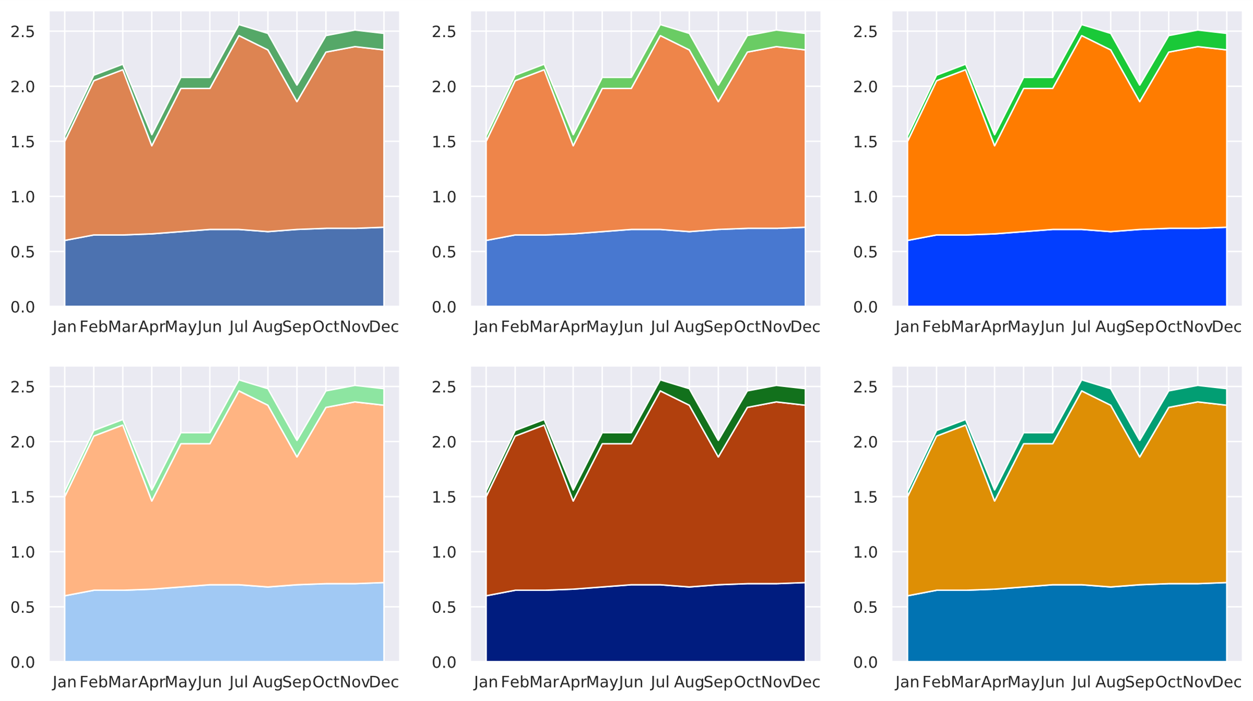
The seaborn.color_palette() Function (Slide 2 of 2)
'deep'
'muted'
'bright'
'pastel'
'dark'
'colorblind'

Slide 66
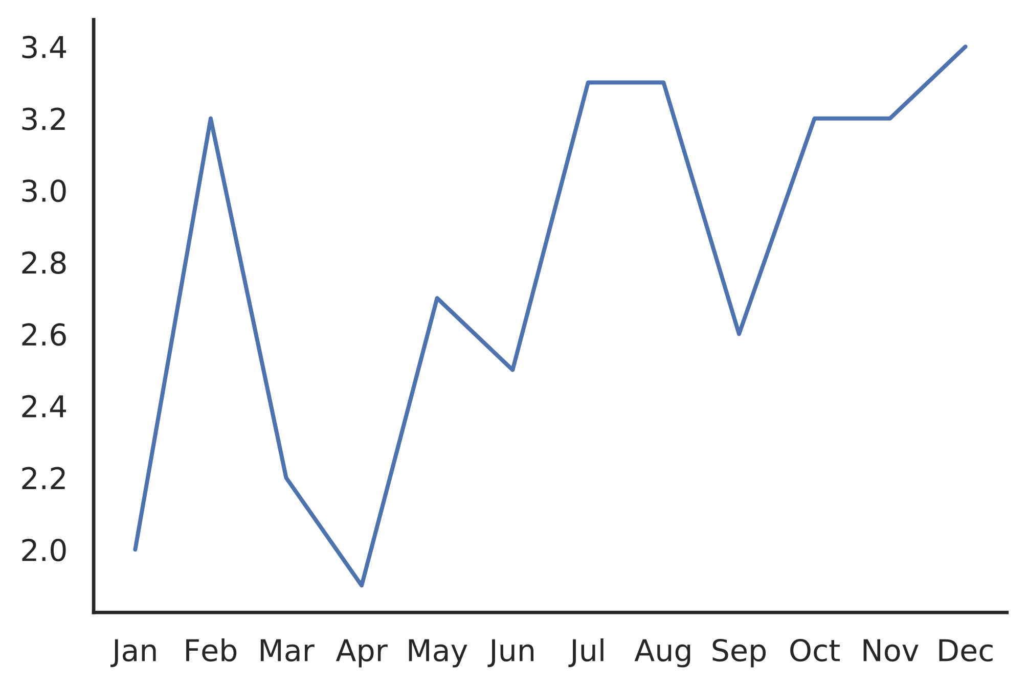
The seaborn.despine() Function
... # Plotting code.
seaborn.despine()
Spine removed
Spine removed

Slide 67
Axes-Level Functions
Seaborn has its own plotting functions.
Divided into two types: axes-level and figure-level.
Axes-level functions return Matplotlib Axes object.
Drawn independent of Figure object.
Most functions that output a single plot are axes-level.
You can supply data in several forms:
A list, NumPy array, or other series of data.
Names of columns in a DataFrame.
Entire DataFrame to plot all columns.
You can use the same object-oriented approach to plot Axes objects.

Slide 68
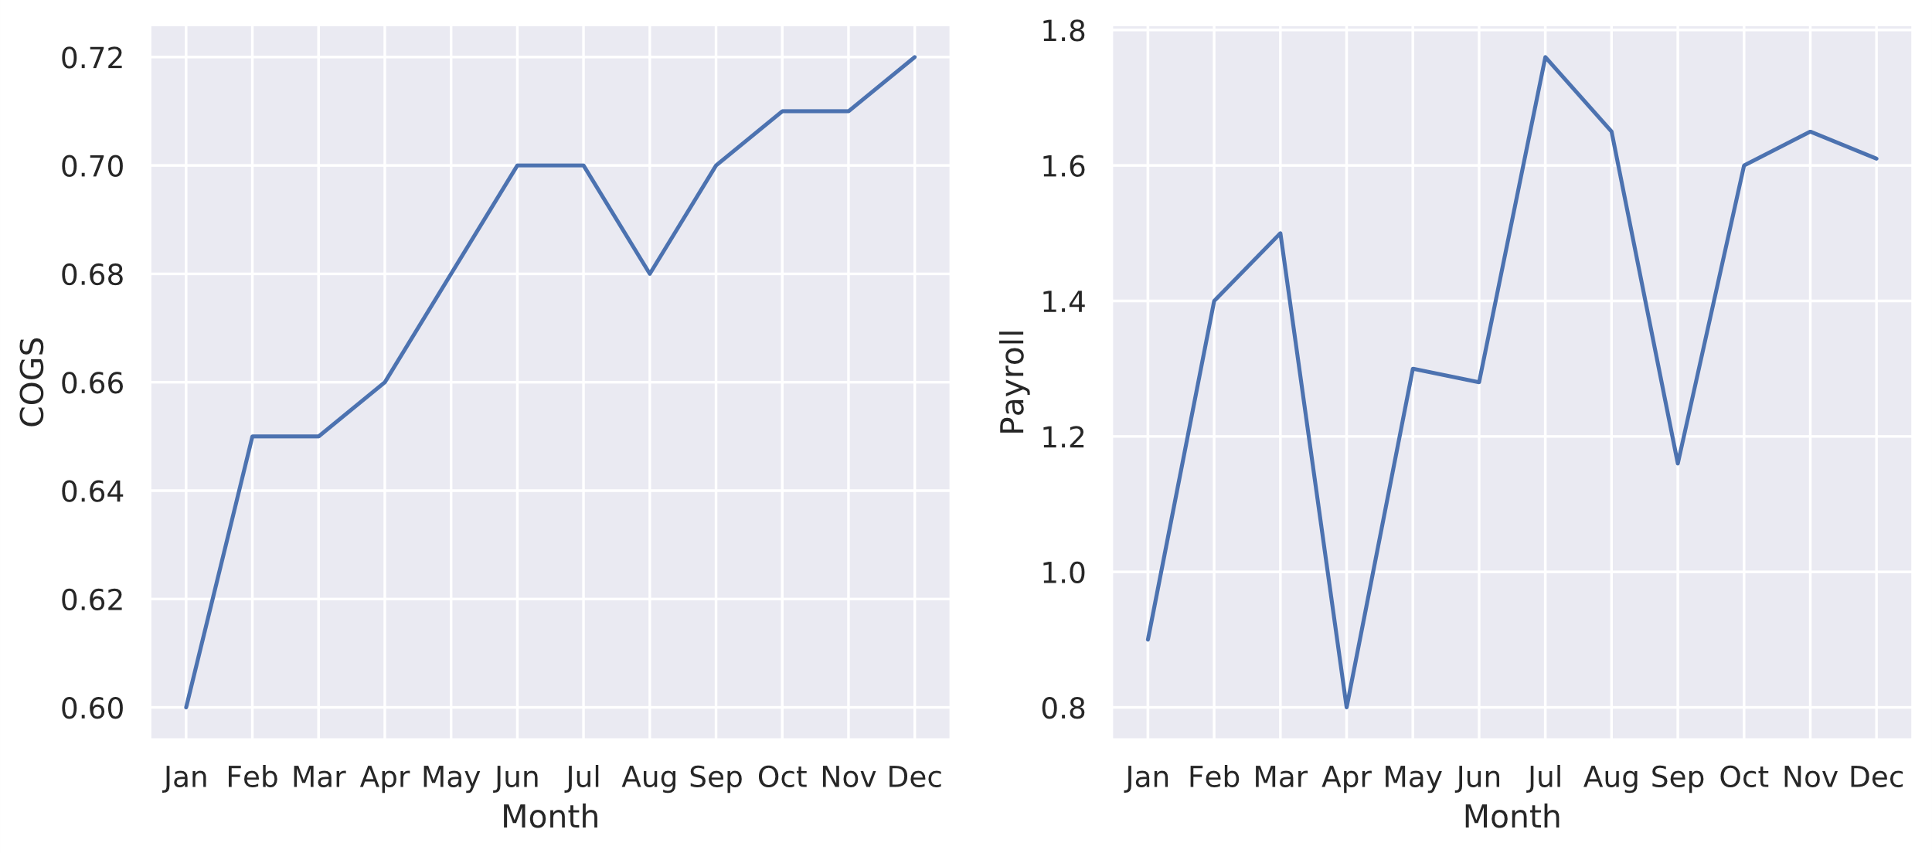
Line Plot Example
fig, ax = plt.subplots(1, 2, figsize = (12, 5))
seaborn.lineplot(x = months, y = 'COGS', data = slice_2019,
sort = False, ax = ax[0])
seaborn.lineplot(x = months, y = 'Payroll', data = slice_2019,
sort = False, ax = ax[1])
Axis 0
Axis 1

Slide 69
Figure-Level Functions
Control an entire Figure object.
Each figure has multiple Axes objects.
Used to show relationship between multiple plots.
Three general types:
FacetGrid —Shows relationship between x and y using subsets of data.
PairGrid —Plots each variable against every other variable.
JointGrid —Takes two variables and generates a scatter plot and two histograms.
Saves a lot of time and typed code.

Slide 70
FacetGrid Example (Slide 1 of 2)
Census DataFrame with new Married column:
City Size Income Age Married
0 Olinger 2 43112.03 27 Yes
1 Greene City 5 78267.56 41 No
2 Olinger 2 37651.32 29 Yes
3 Carbon Creek 2 123714.98 45 No
4 Agerstown 4 83120.54 53 Yes
...
Compare average age of income generators to income.
Does relationship change based on city and married status?
Define FacetGrid object first:
grid = seaborn.FacetGrid(row = 'City', col = 'Married',
data = census_df, aspect = 1.5)
Call map() function with plot type and data:
grid.map(seaborn.scatterplot, 'Age', 'Income')

Slide 71
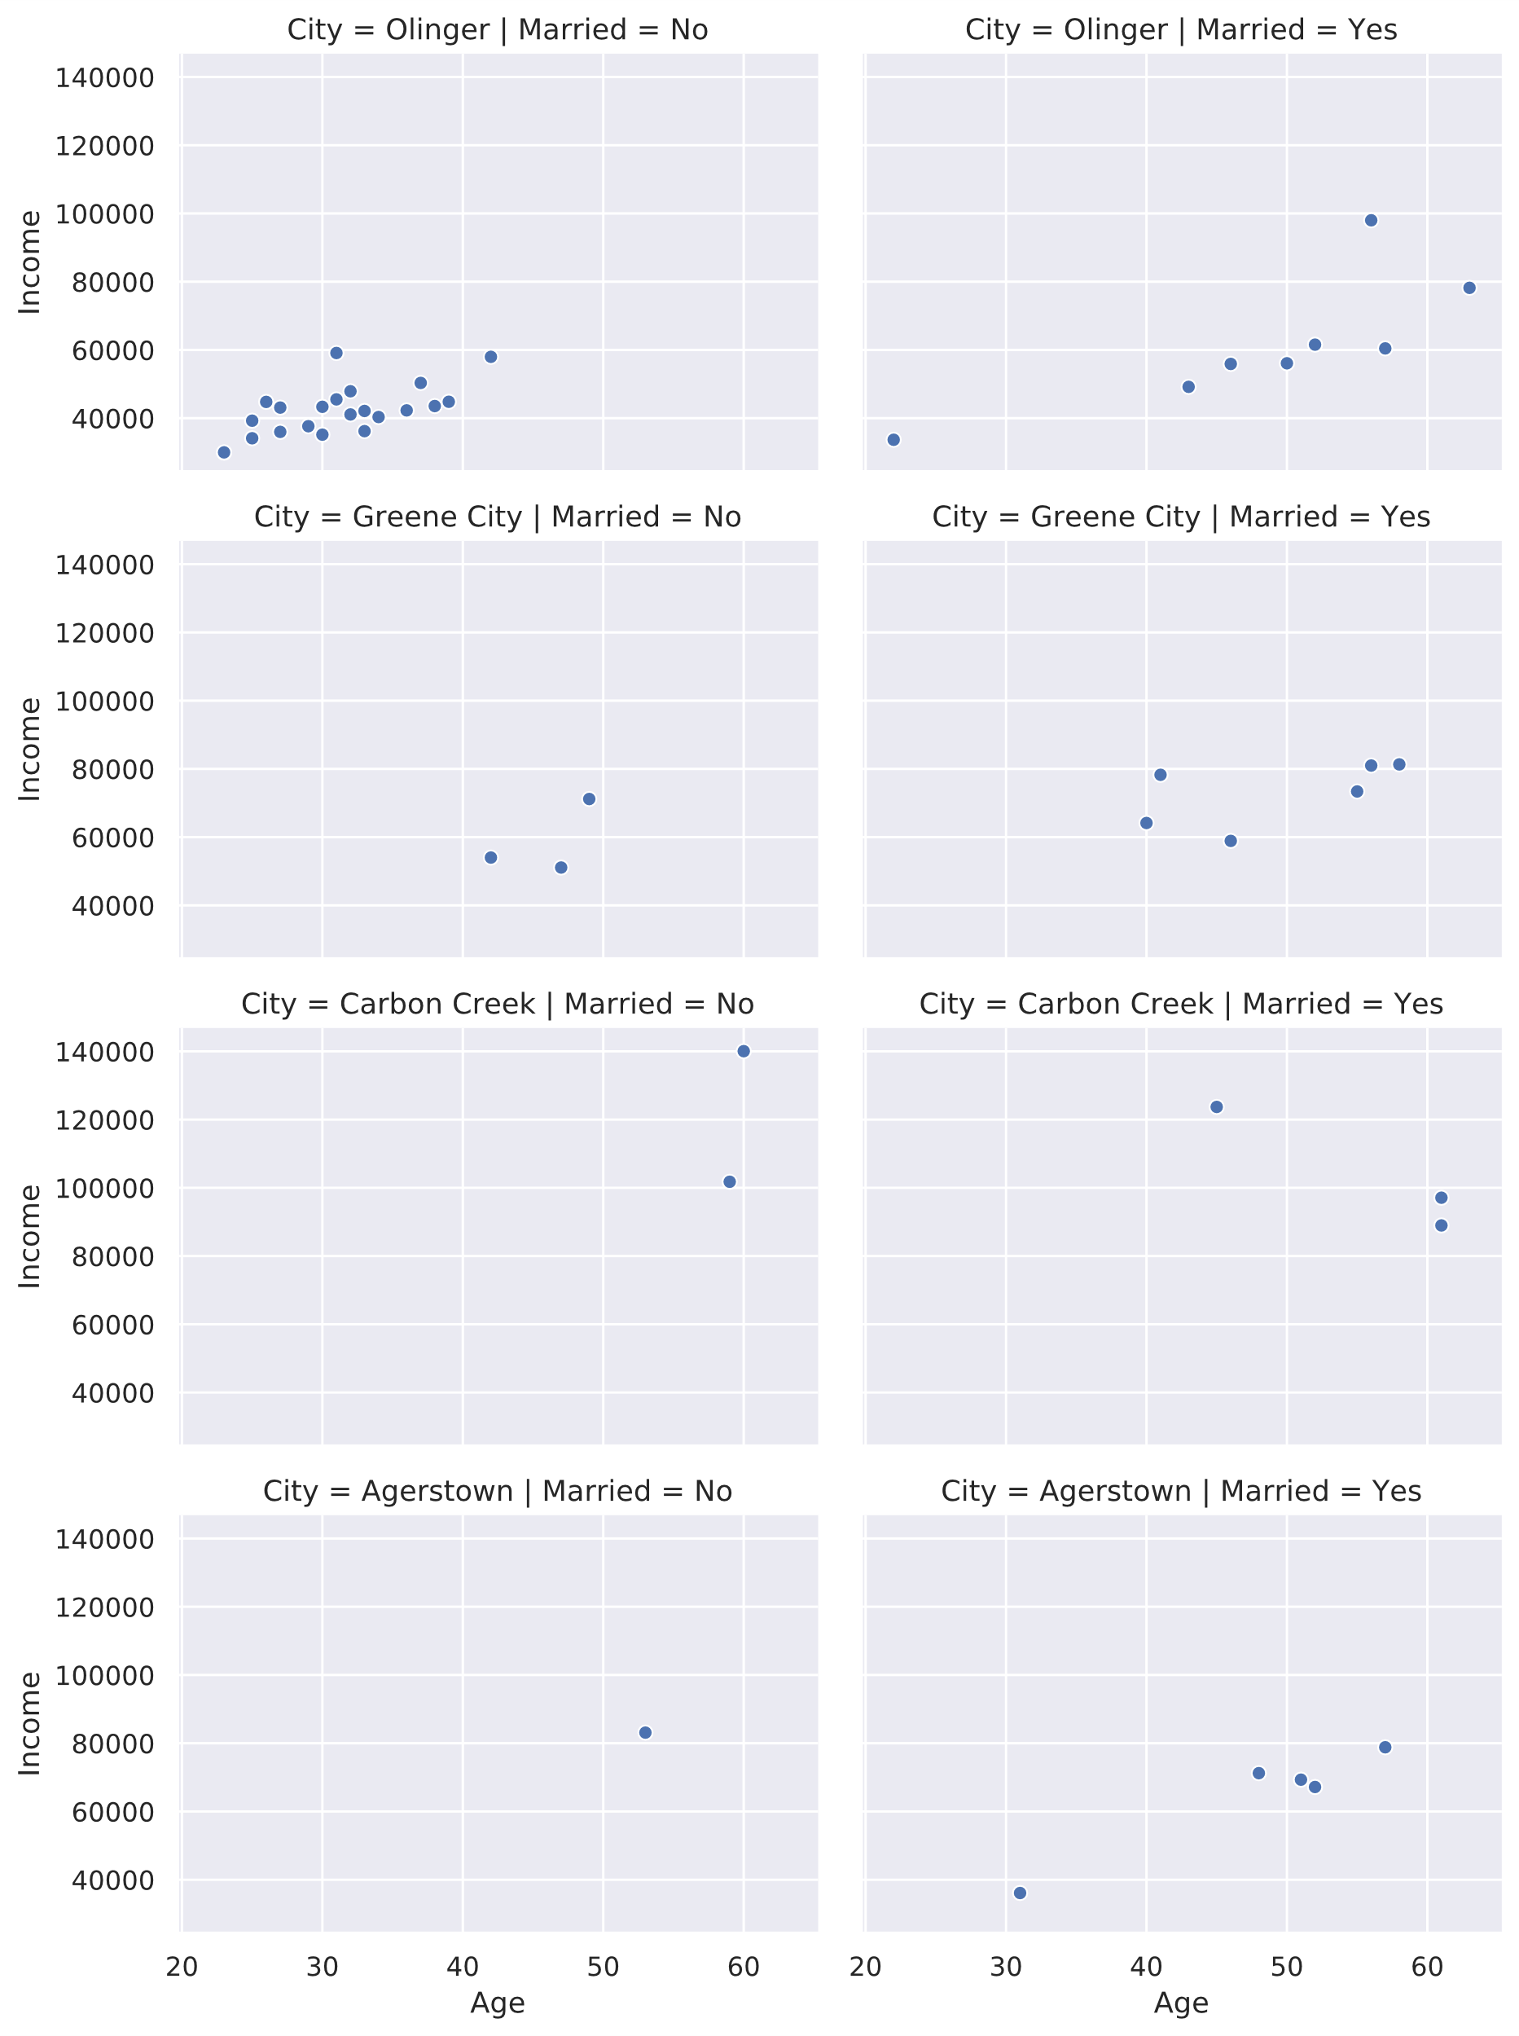
FacetGrid Example (Slide 2 of 2)
City condition
Married condition

Slide 72
Plot Type Categories
Relational plots
Distribution plots
Categorical plots
Heatmaps
Regression plots

Slide 73
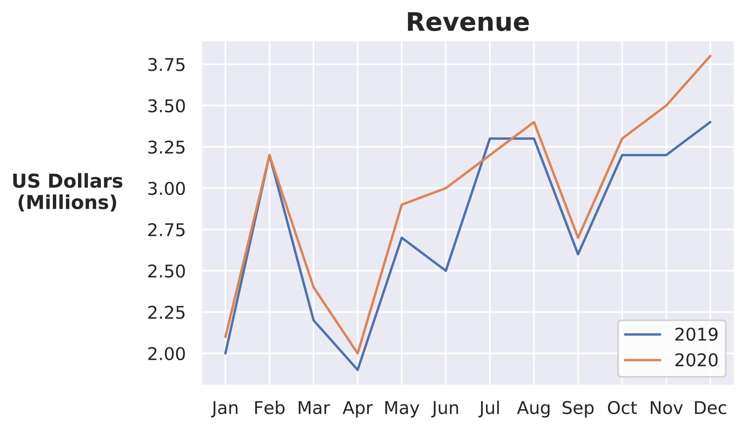
Relational Plots
seaborn.lineplot(x = months, y = 'Revenue', data = slice_2019,
sort = False, ax = ax)
seaborn.lineplot(x = months, y = 'Revenue', data = slice_2020,
sort = False, ax = ax)

Slide 74
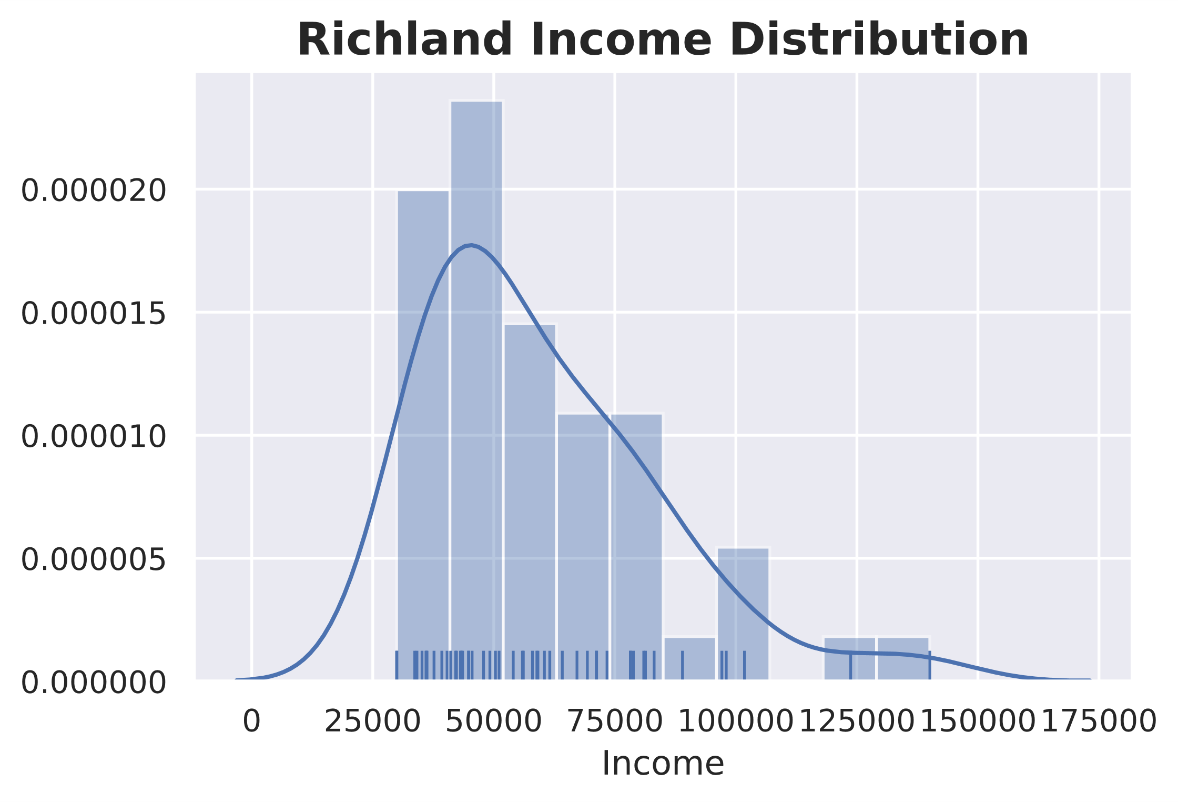
Distribution Plots
seaborn.distplot(a = census_df['Income'], bins = 10, rug = True)
Histogram bin
KDE curve
Rug values

Slide 75
Categorical Plots (Slide 1 of 2)
Categorical distribution plots:
boxplot() —Standard box plot.
boxenplot() —Enhanced box plot (more quantiles).
violinplot() —Violin plot with KDE.
Categorical estimate plots:
countplot() —Simple quantitative bar chart.
barplot() —Plots categorical variable against numeric variable using an estimator.
pointplot() —Similar to bar plot, but represents each estimate as a point.
Categorical scatter plots:
stripplot() —One variable is categorical, other is numeric. Introduces "jitter" to spread out points.
swarmplot() —Same as strip plot, but ensures no points overlap.

Slide 76
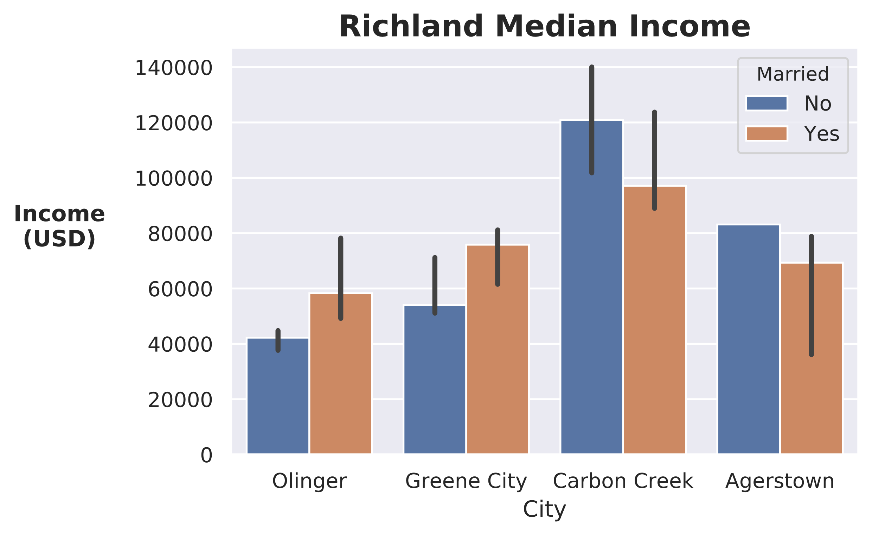
Categorical Plots (Slide 2 of 2)
seaborn.barplot(x = 'City', y = 'Income', hue = 'Married', data = census_df,
estimator = numpy.median)
Error bar
Median

Slide 77

Heatmaps
seaborn.heatmap(slice_2019.corr(), annot = True)
Strong positive correlation
Weak positive correlation

Slide 78

Linear Regression Plots
seaborn.regplot(x = 'Age', y = 'Income', data = census_df)
Line of best fit

Slide 79
Guidelines for Plotting with Seaborn (Slide 1 of 2)
Consider using Seaborn plotting functions over Matplotlib equivalents.
Remember that Seaborn integrates with Matplotlib.
Supplement Seaborn with Matplotlib formatting functions.
Use seaborn.set() to reset the look and feel of plots.
Use seaborn.set_style() to set a "permanent" style.
Use seaborn.axes_style() to set a temporary style.
Use seaborn.color_palette() to set a temporary color palette.
Consider using seaborn.despine() to clean up the plots.

Slide 80
Guidelines for Plotting with Seaborn (Slide 2 of 2)
Use axes-level functions:
Use line and scatter plots to show relationships between variables.
Use distribution plots to show the spread of continuous variables.
Use categorical plots to demonstrate categorical variables.
Use heatmaps to show correlations or other numerical changes.
Use linear regression to show a line of best fit.
Use figure-level functions:
Use FacetGrid to show relationship between variables using subsets of data.
Use PairGrid to plot each variable against each other.
Use JointGrid to show types of different distributions for two variables.

Slide 81
Activity: Streamlining Plotting with Seaborn
You've had success reporting to GCE business leaders.
You've been asked to give regular reports.
Since you'll be generating more plots, you want to streamline the process.
You'll use Seaborn to make things easier, and to generate more advanced plots.
In the future, you plan to incorporate Seaborn plotting into a data science pipeline.

Slide 82
What kinds of plots do you think you'll create most often on the job?
Do you think you'll use Seaborn over Matplotlib, or would you prefer just using Matplotlib directly? Or, do you think you'll use both? Why?

